Slide 1
Research proposal workshop
Tips on writing your research proposal

Slide 2
At Weber State University, opportunities abound for students to pursue independent research. From independent study courses, to university grants, and WSUSA Summer Research Fellowship Programs, WSU is committed to high impact practices.
The following Research Proposal Workshop was developed to provide you with the knowledge you need to write a successful proposal. We will discuss tips and go over the research grant proposal application.
For further assistance, consult with your professors, email Dr. Therese Cavlovic (tcavlovic@weber.edu) in the Office of Undergraduate Research, or contact a member of the Undergraduate Research Committee.

Slide 3
Overview of workshop
WRITING A PROPOSAL
Part I. Formulation
Part II. Composition
Part III. Revision
Part IV. Editing
THE APPLICATION
Submitting the application
CONTACT INFO

Slide 4
Part I. Formulation
Early development can be key to the success of your proposal. Before you begin writing, think critically about your project.
Tip #1: Choose a good topic. Your faculty mentor should help you to narrow and clarify your topic, so that your proposal is specific, focused, and more importantly, manageable. The best research topic, however, will be the one you're most excited about. If you aren't fascinated and galvanized by your research topic, your readers won't be excited either.

Slide 5
Part I. Formulation (continued)
Tip #2: Do your preliminary research. Read widely in your subject area before you begin writing. Become familiar with the field, its principal issues, and major contributors. An annotated bibliography is helpful, and it is even recommend to include it as addenda to your proposal. Consider what contribution your research will make. By the time you sit down to write your proposal, you should know what you want to research, but you should not yet be trying to synthesize your research.

Slide 6
Part II. Composition
Writing the proposal is often the most difficult component of a research project. Be prepared: give yourself enough time to write, rewrite, and revise.
Tip #3: Talk about your ideas! Talk to friends, family, and faculty to clarify your ideas. Schedule a "pre-draft" advising session in the Office of Undergraduate Research. Free-write as a way of getting your ideas on paper. Get your ideas down first; then think about how to organize them!

Slide 7
Part II. Composition (Continued)
Tip #4: Study successful proposals. The Office of Undergraduate Research keeps copies of successful grant proposals. Browse through the files, and model your budget requests after those that are similar to yours.
Sample Grants – Contact us at OUR@weber.edu if you need other examples.
Research Scholarships (for long term grants) will be scrutinized, so be certain to indicate the amount of time that your research will require.

Slide 8
Part II. Composition (Continued)
Tip #5: Be specific.
Take time to consider your research methods and plan a budget. Don't just guess and say, “Materials: $500." Get online quotes for a realistic estimate and make an itemized list of all required materials.
Approach your methodology and research timeline in the same way; if you need to make adjustments later, you can. It is important, though, that you convince the committee that not only is your project doable – you've figured out how to do it.

Slide 9
Part II. Composition (Continued)
Tip #6: Be concise. Clearly differentiate the various parts of the proposal. For instance, in your methods section, talk only about your methods. Leave out extraneous information.

Slide 10
Part II. Composition (Continued)
Tip #7: Write to the audience. The awards committee consists of faculty from a variety of academic disciplines. Your proposal should not be so discipline-specific and jargon-laden that outside readers won't understand. On the other hand, don't dumb your language down so that you insult the educated reader. If necessary, the committee will ask a specialist for an opinion on the project's viability. As you revise, consult a variety of readers, both in your discipline and outside it.
Put your research question or the purpose of your project right up front.
Use present tense while writing your research proposal. Avoid using first person.

Slide 11
Part III. Revision
Revision is critical. Don't expect to write one draft of your proposal and be awarded a grant. A good proposal will take several revisions; be sure to give yourself time.
Tip #8: Communicate with your Committee Rep. and Research Mentor At least 2 weeks prior to the deadline, reach out to your college’s undergraduate research committee (URC) representative and your mentor and tell them your intention to submit a grant proposal. With them, schedule a date that you will provide them a final copy (i.e., not a first draft) of your proposal for them to review and possibly sign. They will likely provide you with comments that you should address in a revision. It is likely that they will not sign on the first go around. You will need to plan accordingly so that you are able to incorporate their comments, provide a revised version, and obtain their signatures by the due date. You are responsibility for turning in a final edited draft with all appropriate signatures. All errors and omissions will be your responsibility.
Research Committee Representatives

Slide 12
Part IV. Editing
Reread your proposal several times before submitting to the committee.
Tip #9: Avoid errors. Because errors are easily introduced during the revision process, be sure to reread your text carefully each time you make changes. There is no excuse for grammatical and spelling errors in a grant proposal. Use spell checker, by all means, but don't rely on it completely. There's no substitute for careful proofreading.

Slide 13
Part IV. Editing (continued)
Tip #10: Make it professional.
Take some time to format your proposal neatly and follow instructions. Use headings and sub-headings where appropriate. Keep in mind that headings will help readers understand your proposal. A good layout is easier on the eyes of committee members who will be reading many proposals.
don't go cutesy, with brightly colored paper and fancy fonts.

Slide 14
There you have it: 10 tips to help you write a successful grant proposal.
But keep in mind granting awards is a competitive process. Even if you do everything right, there's still an element of luck. In the world of grant applications, your chances of success depend also on the number and quality of proposals in your subject area. If your proposal isn't accepted, don't view it as a personal attack on your research abilities or your topic. If your project is viable, look for funding from another source, or consider applying again in the next funding round.

Slide 15
THe Proposal Application
This section of the Workshop goes over everything you need to know to submit your grant proposal. These tips are included to help you avoid the common mistakes we see in unfunded proposals.
The next slides cover the proposal application and what the URC representative will be reviewing.
If you have not written your proposal yet, please pay special attention to the tips included in this section.
If you have already written your proposal, please review this section to check for errors and take advantage of the tips.

Slide 16
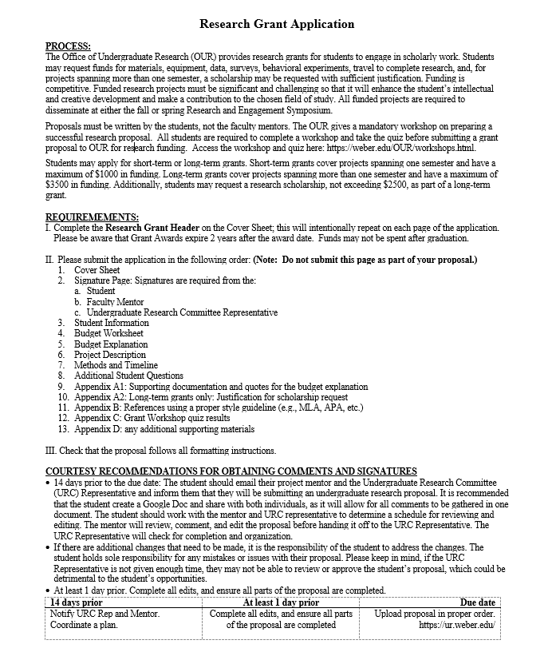
Pay careful attention to the timeline and deadlines listed
The Grant Committee will meet shortly after the deadline to review proposals. Your mentor will receive an email/letter stating whether a project received funding.
This page is just for instruction and timeline. You should not turn it in with your proposal.

Slide 17
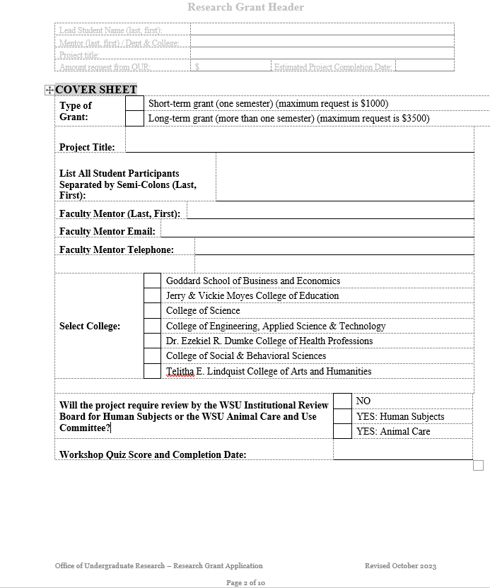
Make sure this is the amount you are requesting from OUR.
Complete the header on this page. Just double click and enter the requested information.
Each student participants must complete the workshop. Enter each students score and completion date

Slide 18
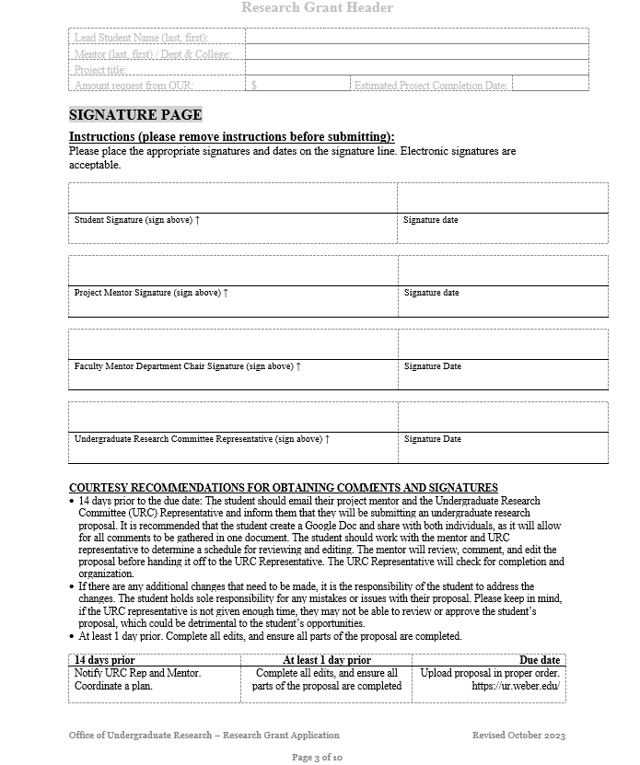
Please be respectful of your mentor’s and URC representative’s time and work with them to revise your proposal and obtain signatures.
Your signature and your mentor’s signature are required.
Additionally, we request signatures for your Research Committee Representative and your Faculty Mentor’s Department Chair. These signatures show support for a strong proposal. Try to get all of the signatures for the strongest proposal.

Slide 19
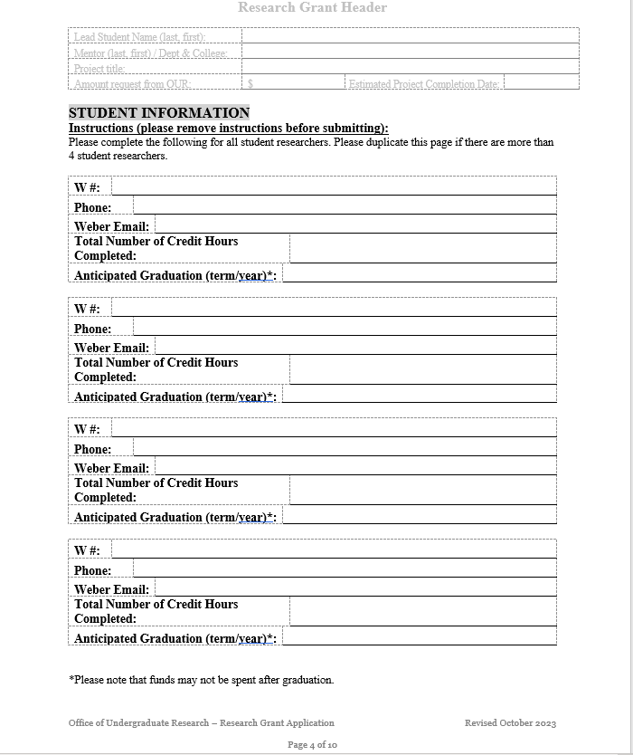
Complete the student information for the lead student and any additional students.
Obtain signatures from all participating students.

Slide 20
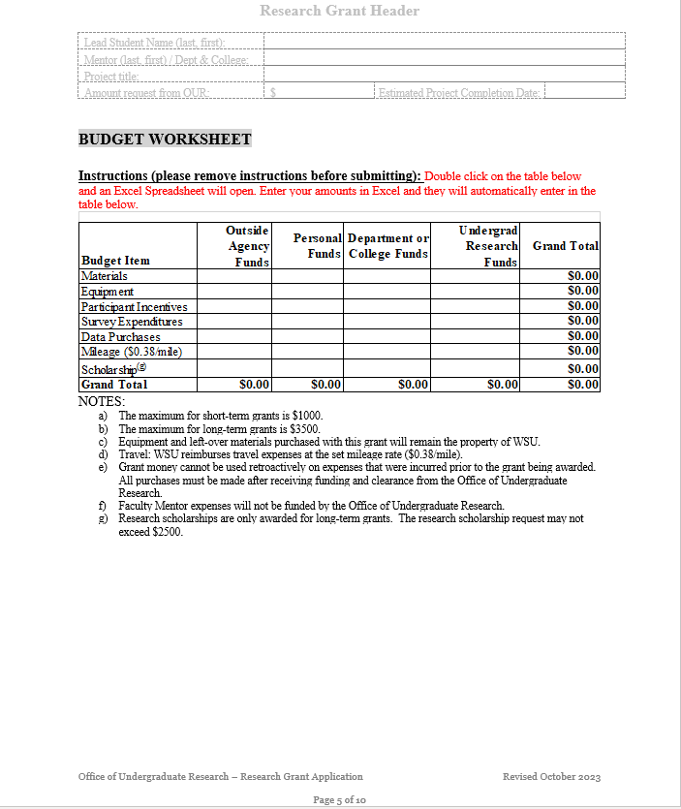
Double click on the budget sheet and an Excel spreadsheet will open.
A short, concise description of your budget items is ideal. Go into more detail, in the budget explanation included in the body of the proposal, and add quotes/additional supporting docs to the addendums A1 and A2 (if necessary).
Be sure to include all funding and resources you will be utilizing.
Feel free to edit the Budget Item headings to better reflect your personal budget request.
Check that your columns and rows total correctly.

Slide 21
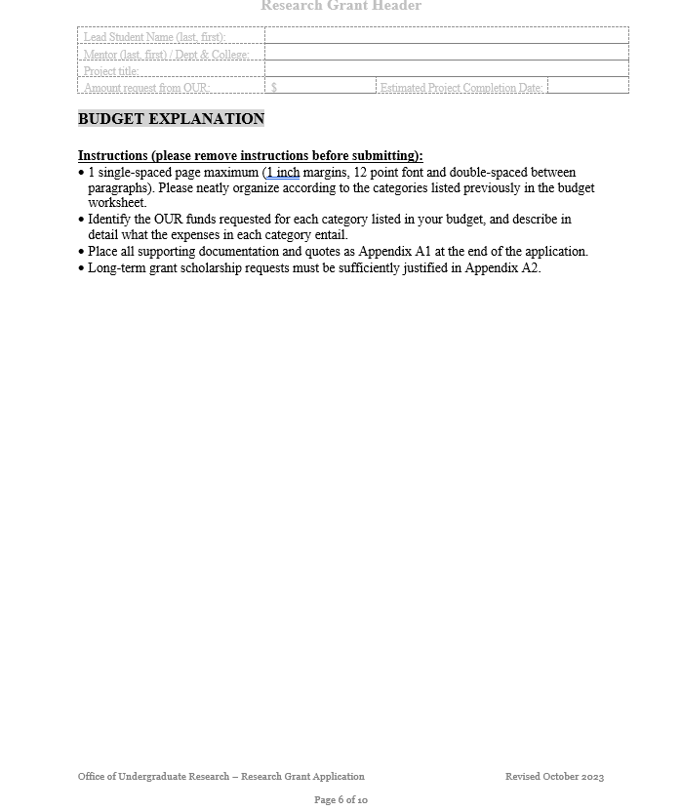
Keep the heading.
Remove all instructions before submitting.
Single space within a paragraph and double space between paragraphs. An example is provided.

Slide 22
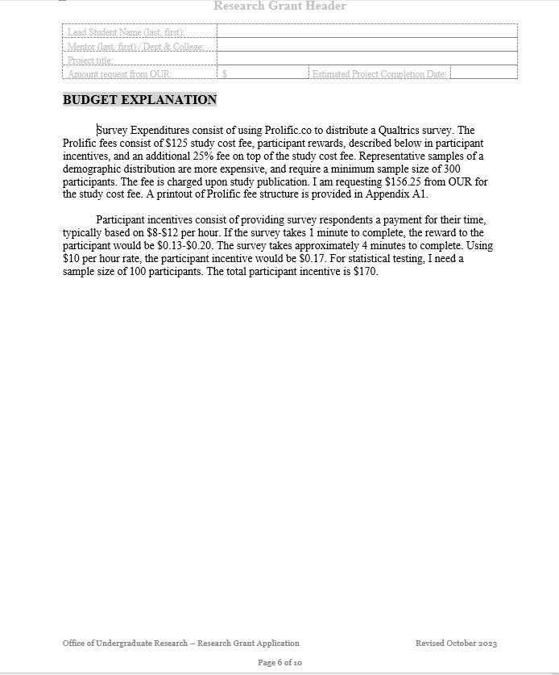
Keep the heading.
Remove all instructions before submitting.
Single space within a paragraph and double space between paragraphs. An example is provided.

Slide 23
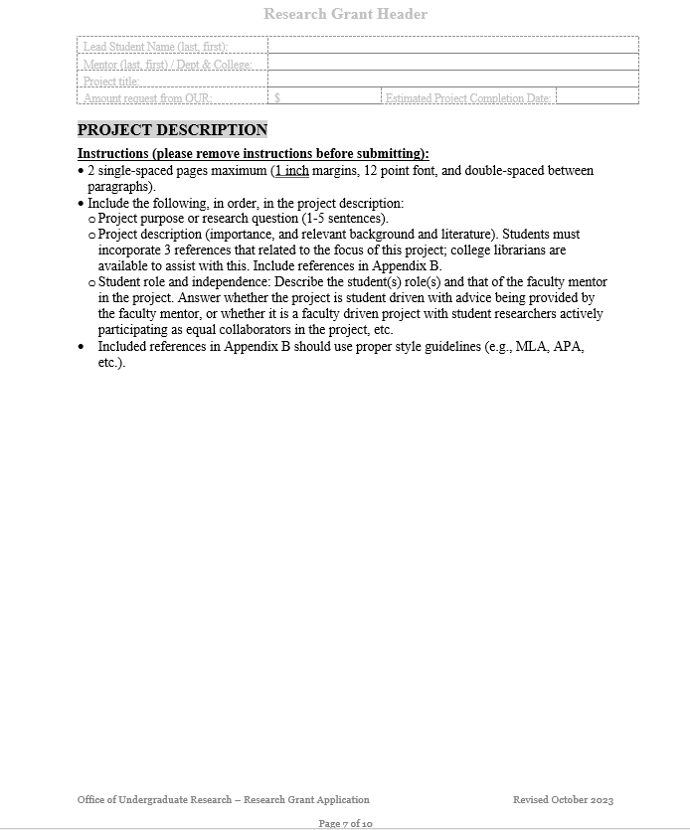
Please be sure to delete all of the instructions on the page.
Keep the heading.
The very first thing to write is the purpose of your project or your research question.
Include the three resources, as well as any additional citations, in Appendix B

Slide 24
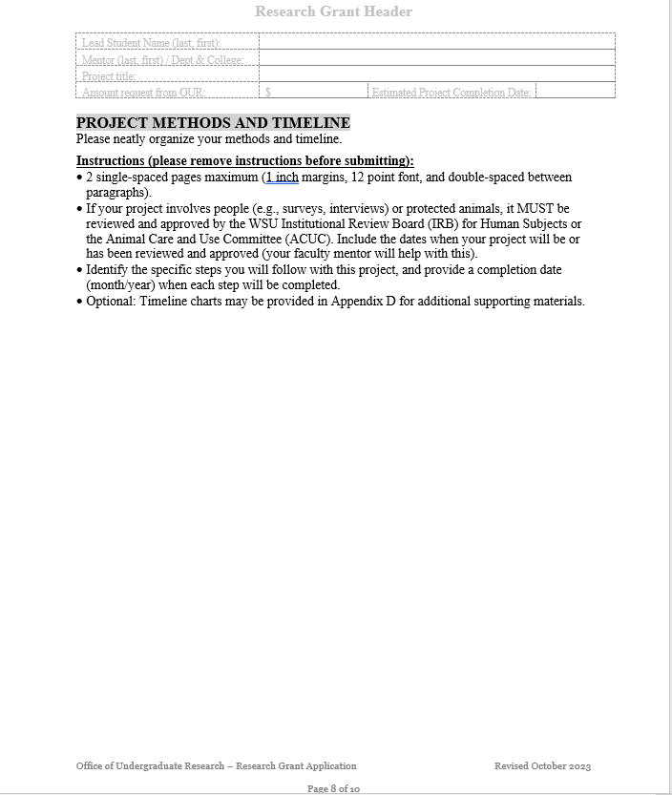
Please be sure to delete all of the instructions on the page.
Keep the heading.
Some students include Gantt charts as optional materials. Please place in Appendix D.

Slide 25
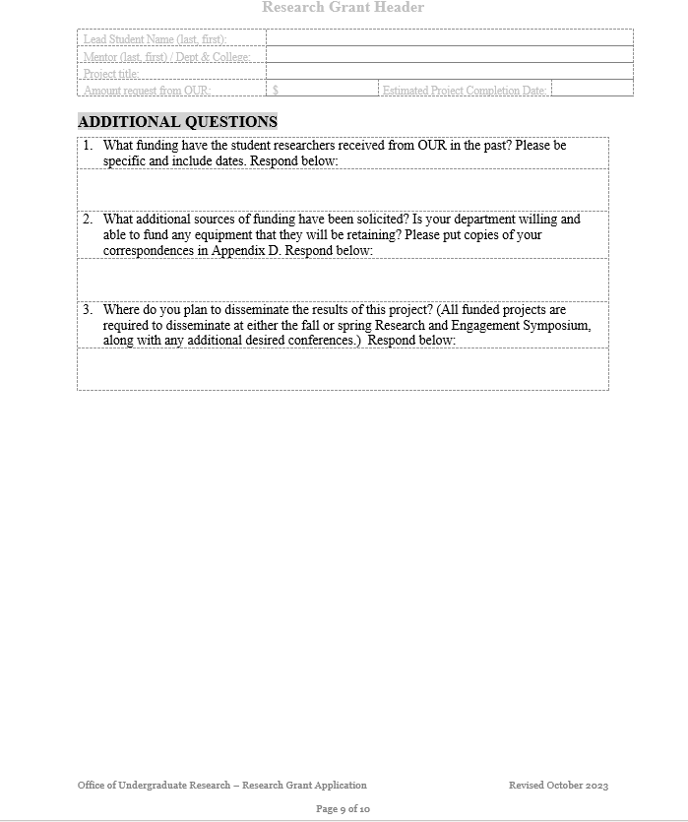
Keep the heading
Answer all questions in complete sentences.
Demonstration that you have requested funds from your department, college, or other sources should be included in Appendix D

Slide 26
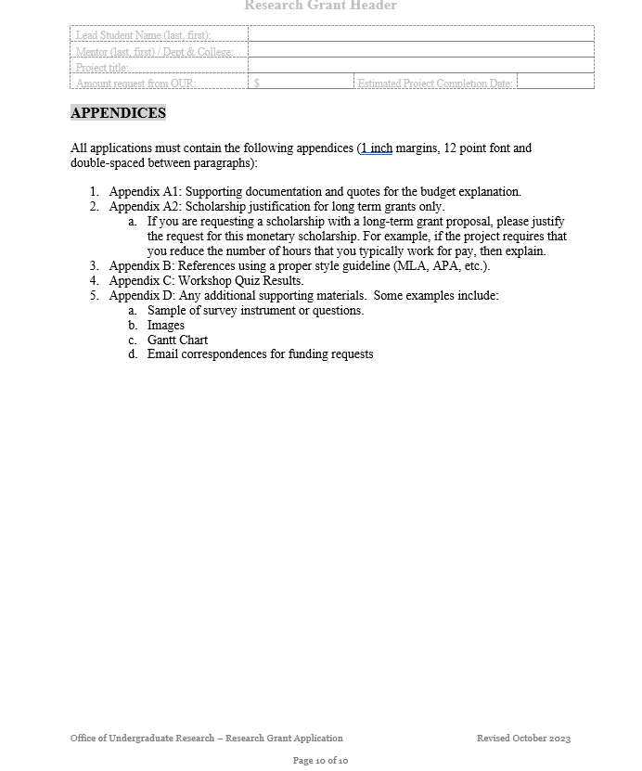
This page just outlines all the required appendices. It is recommended that you include this page, and each appendix would follow. Please include a title on each page for the Appendix.

Slide 27
Which type of grant should I submit?
The Office of Undergraduate Research offers three types of grants.
Long Term Grants: Maximum budget of $3500. Used for in-depth research projects that may span multiple semesters.
Short Term Grants: Maximum budget of $1000. Used to support research that is exploratory or part of coursework.
Travel Grants: Maximum budget of $1000. Used only when your research is complete – this is to disseminate your findings at a conference.
For more details, visit OUR's Grant Page

Slide 28
How do I submit my proposal?
Please submit your electronic proposal to our online submission site: Online Submission
Login with your eWeber username and password
Choose “Research Grants,” and then select “My Submissions”
Please refer to OUR’s Calendar for deadlines.

Slide 29
Workshop Quiz
Please complete the online quiz upon completion of this workshop. Information you will need to complete the quiz includes:
Faculty mentor name
Faculty mentor department and college
Completion of this workshop to answer specific questions about submitting a grant.

Slide 30
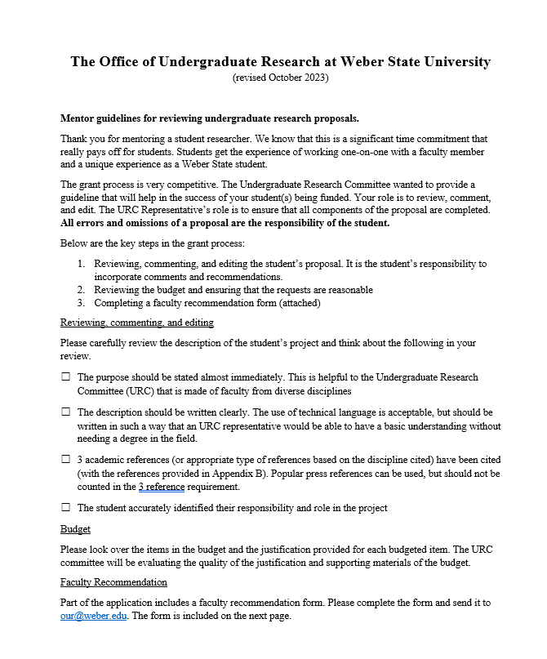
The Mentor Guidelines for reviewing student research proposals

Slide 31
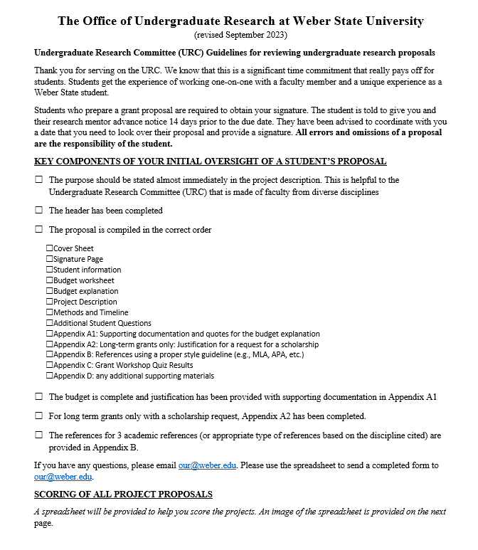
The URC Guidelines for rating student research proposals

Slide 32
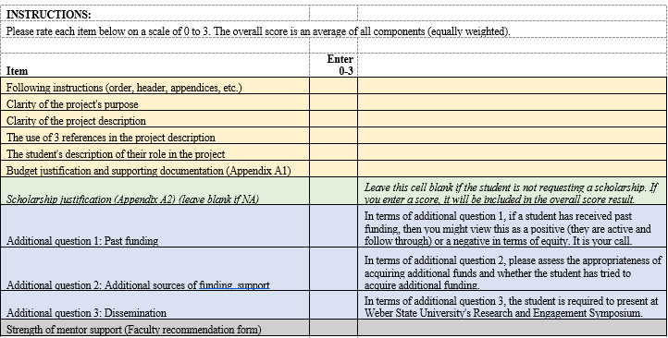
The URC Guidelines for rating student research proposals

Slide 33
Questions or Concerns
For any proposal questions, please feel free to contact Erin.
Dr. Cavlovic | Director
Email: tcavlovic@weber.edu
Text: 801-394-3782
Tracy Covey | Assistant Director
Email: tracycovey@weber.edu
Website: www.weber.edu/our
Email: our@weber.edu
Erin Kendall | Administrative Assistant
Email: erinkendall@weber.edu
Text: 801-663-1655

