Slide 1
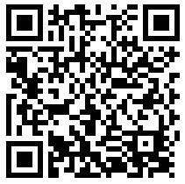
WSUSA Training Attendance
September 30, 2020
Use the QR Code or the link below to complete the attendance form and be entered into a drawing for a limited edition WSUSA baseball jersey and/or other swag!
Link:
https://tinyurl.com/y59coffo

Slide 2
Unconscious Bias and Populations within the WSU Community
Diversity & Inclusive Programs
9/30/2020- WSUSA Training

Slide 3

Who am I? Why is this work important to me?
Background
  Position on Campus
  Oxnard, CA
    Community
  California State University, Chico
    Student Worker
    Peer Advisor
    Community
  Ogden, UT
    Community

Slide 4
Purpose
Discuss what Unconscious Bias is
Recognize Unconscious Bias within our interactions
Learn how Unconscious Bias impacts the individuals we support
Give us tools to confront and change unconscious bias (T.I.D.E)

Slide 5
How do WE Achieve
Community at WSU?
You Are more than your job description
  Connector
  Mentor
  Facilitator
You are part of the Bigger Picture
  WSU Core Values
    Learning through personalized experiences and shared inquiry
    Engagement in community
    Access and opportunity for all
    Respect for people and ideas
    Nurturing the potential within every individual
  Changing a culture of Admittance to Acceptance

Slide 6
Terminology
Unconscious Bias -
Unconscious
“not aware of something”
“not intended or planned : not consciously done”
Bias
“an inclination of temperament or outlook; especially: a personal and sometimes unreasoned judgment: prejudice”
Microaggressions - The everyday verbal, nonverbal, and environmental slights, snubs, or insults, whether intentional or unintentional, which communicate hostile, derogatory, or negative messages to target persons based solely upon their marginalized group membership.
Community - A feeling of fellowship with others, as a result of sharing common attitudes, interests, and goals.
Notes:
What is unconscious bias?
How does unconscious bias occur?
What unconscious biases might the individuals that we support experience on a day-to-day basis?
Use this discussion time to really identify biases that can occur around the culture of ability/disability
Once this foundation has been set we will build on the understanding that individuals can experience many other social identities that might further impact their experiences and/or service delivery.
It is important to note that we all have biases, even those of us that are consciously working to overcome biases.

Slide 7
Activity
Reflect
  Write 1-2 assumptions others have made about you that were hurtful and incorrect.

Slide 8
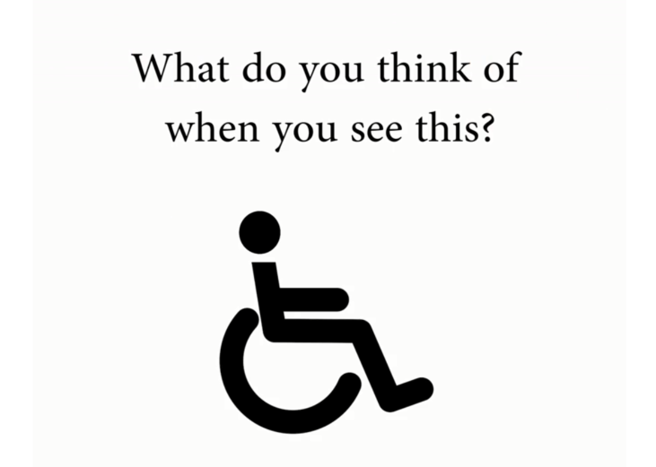

Slide 9


Slide 10
Time to look at ourselves
Self Awareness
  Think about a situation where you once had an unconscious bias. Look back at the reflection activity.
Feedback
  What was the bias?
  How did it impact those around you?
  How did you change that bias?

Slide 11



Slide 12

Notes:
THINK
Reflect on interactions we’ve had with others. Were they respectful? Consider comments that don’t reflect our beliefs or values.
How do we do this?
Think about the things you say. What are the actual meanings of phrases that have been handed down through generations such as “that’s so gay” or “that’s retarded”? These saying and others like it are deeply rooted in bias. It’s good to consider the effect our words and actions have on others.
Most of us would never intentionally say or do things overtly biased or prejudiced, yet we all may say or do things stemming from unconscious bias. Sometimes, we simply don’t give much thought to them. Labeling, generalizing about people or behaviors, asking insinuating questions about attire and gestures, or mocking speech patterns are examples of things we may say and do, just because we always have.
Ask participants to provide examples of unintentional things that may not reflect our values.

Slide 13
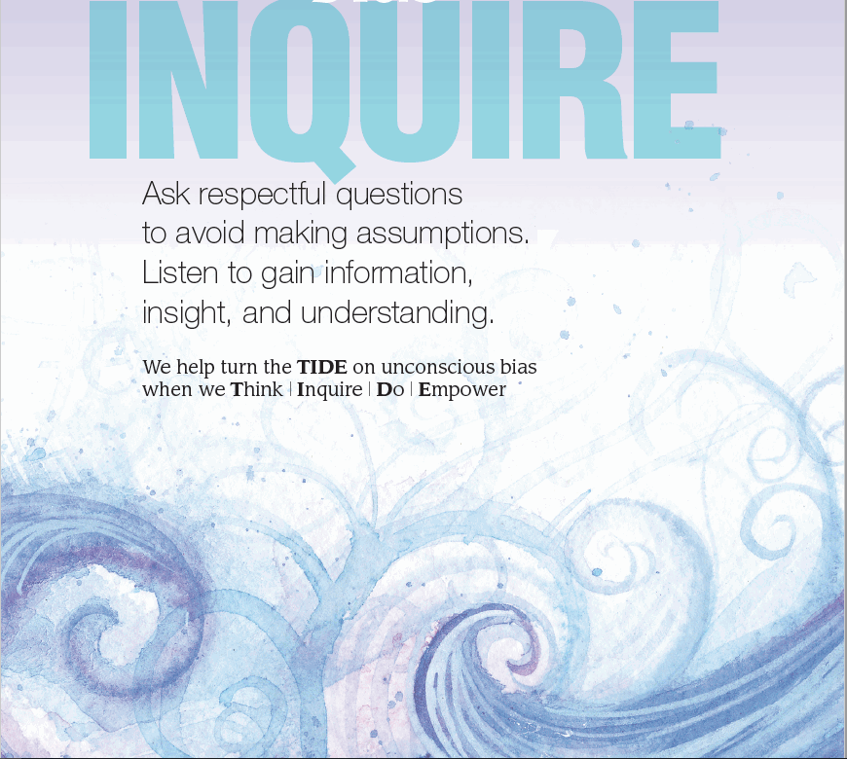
Notes:
INQUIRE: Ask respectful questions to avoid making assumptions. Listen to gain information, insight, and understanding.
How do we do this:
Inquiry is respectful questioning from a place of curiosity and a desire to connect with another person and actively listening.
Respectful curiosity looks at differences through the lenses of humility and admiration. How we ask questions about someone’s personal identity can make all the difference.
Asking “So, what kind of [fill in the blank] are you?” or “Where are you from?” is different than “May I ask you about your cultural background?” or “Are you originally from Utah?” Asking if we can ask expresses openness and safety for the other person to decide what they wish to share about their identity and experience.
Listen closely to the answer, rather than planning your response. When telling their story, people may often reveal clues about whether they have experienced bias. The best response may be: “I appreciate you sharing.”
Being present and listening without refocusing on your response is so important. It reinforces your desire to listen, learn and connect.
Ask participants to provide examples of respectful questioning.

Slide 14
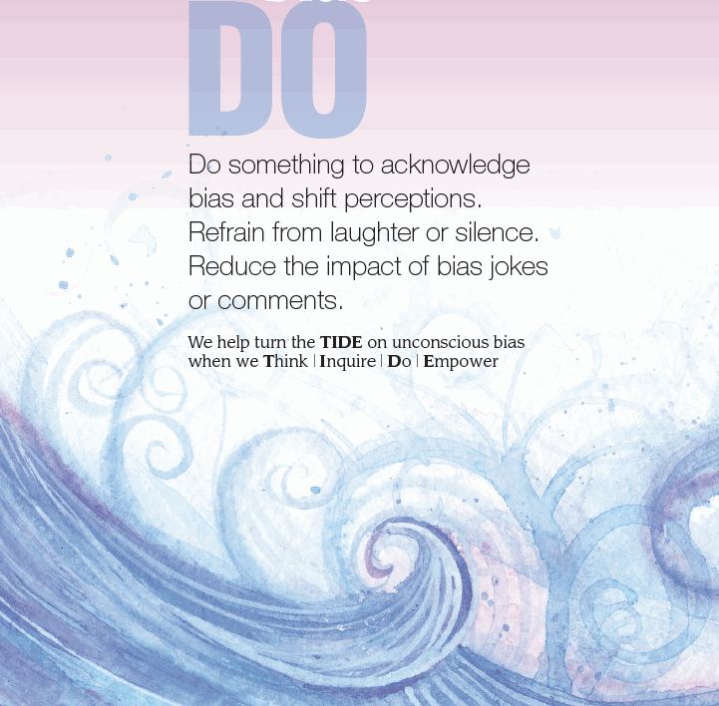
Notes:
DO: Do something to acknowledge bias and shift perceptions. Refrain from laughter or silence. Reduce the impact of bias jokes or comments. Interrupt.
How do we do this:
It’s sometimes difficult to know how to react when we hear comments or see actions that slight, ridicule or mock people.
Acts of bias are so common that we may become immune to their effect or wonder if we are “reading too much into it.” We have a responsibility to DO something to make change. But what?
We can speak up. We can work to educate ourselves and others about how what we say, even unintentionally, can be hurtful and reinforce stereotypes. Don’t laugh or “just to go along with the joke.”
It can be awkward to speak up for others and even more disconcerting to stand up for ourselves. We may feel as if we are being too sensitive or that nothing was really meant by an off-hand comment. The reality is that acts and words of unconscious bias have lasting detrimental effect, regardless of intent. We can change that outcome.
Ask participants HOW they would intervene with situations where unconscious bias in happening. How could they do this while out in the community with those they support?

Slide 15

Notes:
EMPOWER: Model and motivate courageous self-appraisal. Offer opportunities for conversation and education. Thank those who have the courage to think, inquire and do.
Also think about how we would empower individuals with historically underrepresented identities to speak up about bias that is hurting them and become their own self-advocates.
How do we do this:
Thank those who have the courage to think, inquire and do.
Calling out unconscious bias can be scary. Yet we all must have the courage to interrupt the buried beliefs of others and ourselves.
We can raise awareness about and shift unconscious bias. By thanking others when they speak up, we validate their actions. We reinforce their courage and renew their resolve.
The simple act of pointing out a belief rooted in unconscious bias takes bravery. If even one other person chimes in to challenge biased thinking, others are encouraged to be brave as well. We can support each other and create change.
We begin Turning the TIDE on unconscious bias when we do something and empower others through validation, praise and thanks when they have the courage to stop unconscious bias and model support.
Ask participants to provide examples of some of the ways that they can practice self-reflection and how they can empower individuals they support to speak up about biases experience from others (including us).

Slide 16
Being Comfortable in the Uncomfortable
Impossible Knowledge
“ [Impossible Knowledge is] knowledge that is beyond our grasp because of the limits of our language and our lived experience. It is about what happens when we allow ourselves to be in places with the unknown, to recognize our limitations, and to take the time to really listen to people who are not just like us, whoever we may be at that particular moment” (Haig-Brown, 2003, 415-416).
Notes:
It is okay to not know everyone’s experiences, but it is your job to challenge yourself and explore answers.

Slide 17
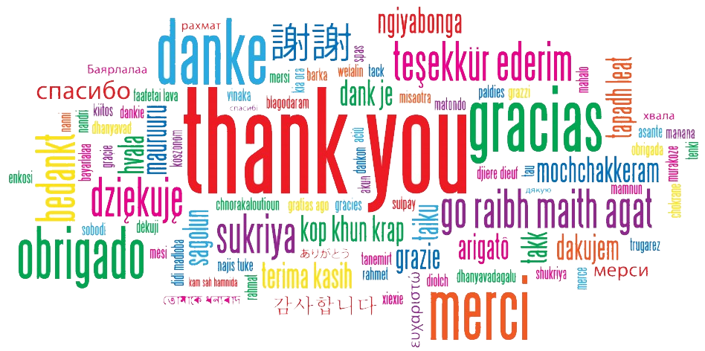

Slide 19
Andrea Hernández
Coordinator,
Diversity & Inclusive Programs
andreahernandez2@weber.edu
801-626-6957

