Slide 1
Club Leadership Training

Slide 2
Items to discuss
Entitlement
Fundraising and matching SFA
Donor clearance process
Donations counting towards a players dues
Receipts – itemized, bring them back
Volunteer clearance process
Activity waiver reallocation

Slide 3
Entitlement

Slide 4
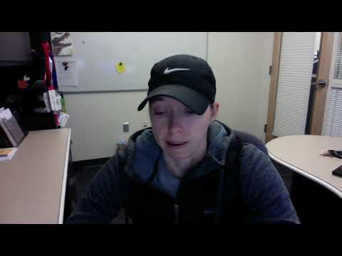
Morgan Fradley
(Competitive Sports Coordinator)

Slide 5
Fundraising (SFA)
-Tanner

Slide 6
Fundraising
SFA Matching
Methods
Dues
Donations
Sponsorship
Notes:
Carwash - Supersonic by Costco
Apparel - Shirts, Hats, etc.
Host a competition

Slide 7
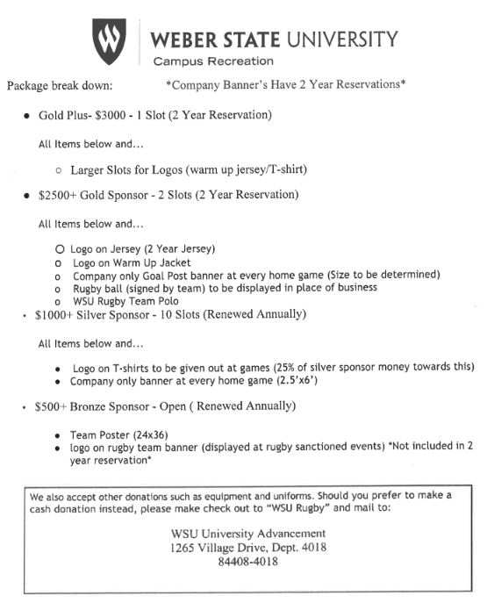

Slide 8
Donor Clearance

Slide 9
Donor Clearance process
Submit Donor Clearance form online
Manager sends it to Development and asks for approval
Once approved, then you may approach vendors

Slide 10
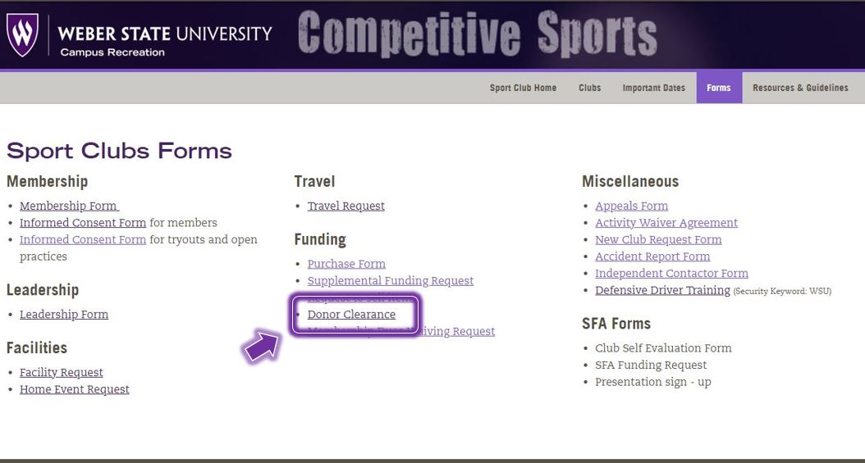

Slide 11
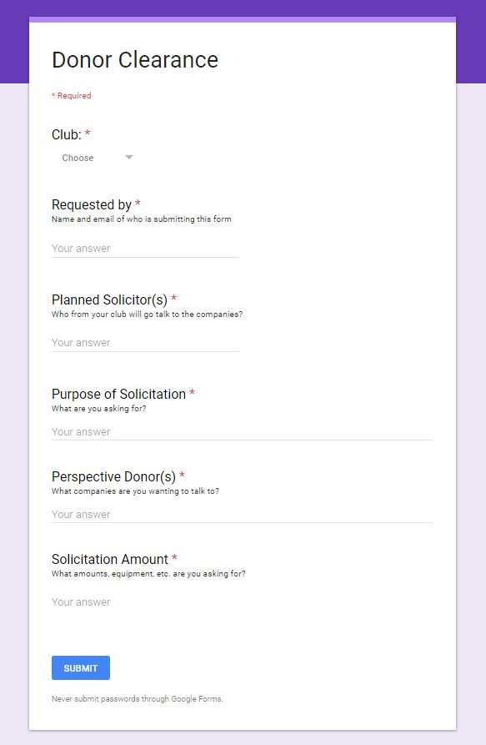

Slide 12
Policy Change
Donations towards a players dues cannot be done for tax write-off (gifts)
If they request nothing in return for their donation, then it's okay

Slide 13
Purchasing (Receipts)

Slide 14
Purchasing
What receipts do we need?
All of them
Is just the total amount on the receipt good?
No, we need the receipts to be:
Tax-Exempt
AND
Itemized
showing everything that was purchased

Slide 15
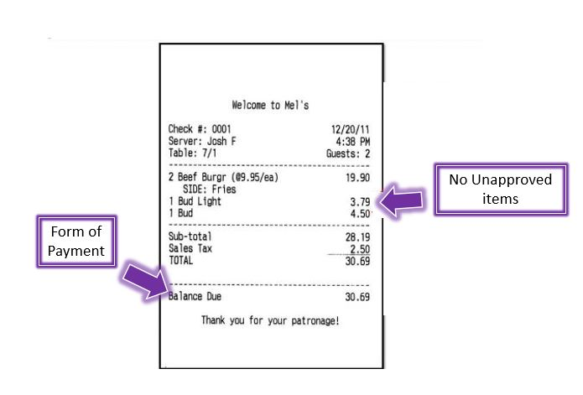

Slide 16
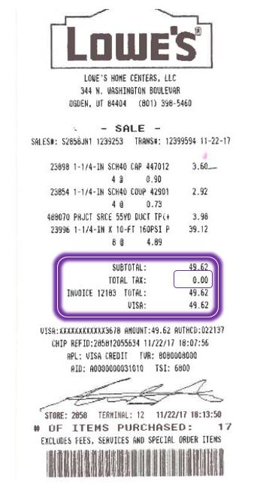
Tax-Exempt
AND
Itemized

Slide 17
Club Volunteers

Slide 18
Club Volunteers
Must be approved BEFORE helping with the club!!
Volunteer Requirements:
Completes membership/consent paperwork
Complete online volunteer application (this starts the process)
Completes background check on campus
Completes canvas training course
Notes:
For the canvas training, Morgan will use the email listed in the volunteer application to enroll the volunteer into the course. The other three forms are online. However, they will need to come on campus to finish the background check. I have attached a screenshot of your volunteers so that you can walk each individual through this process! Let me know if you have any questions.

Slide 19
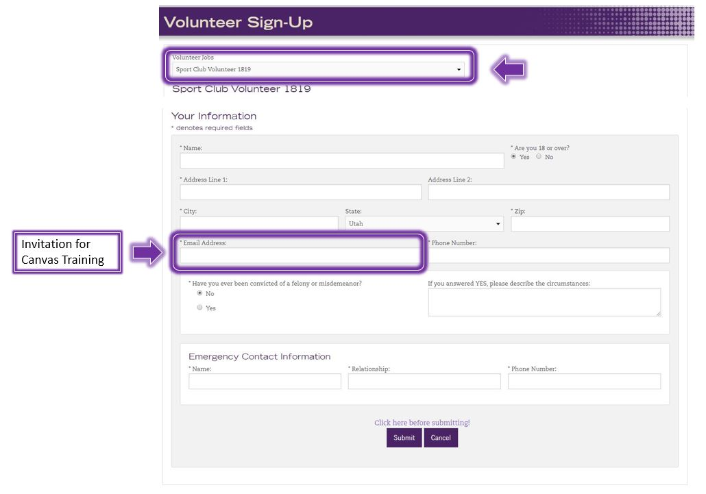

Slide 20
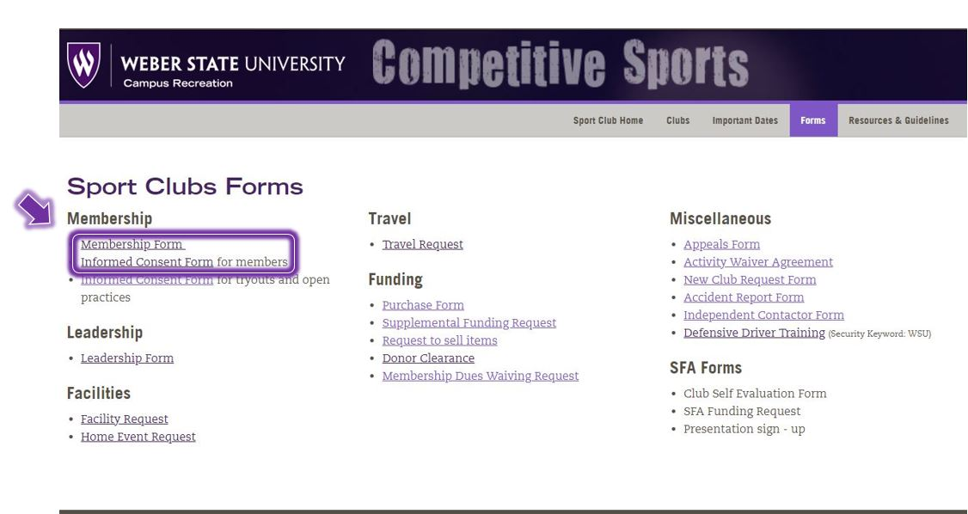

Slide 21
Activity Waivers for Spring
Any changes must be email to Morgan by 5pm December 12th.

