Slide 1

Sport Club Leadership Training
August 30, 2023

Slide 2

Sport Club Leadership Training
Competitive Sports (CoSpo) Staff
CoSpo Managers
Guest Speakers
Morgan, Associate Director
Chloe, Manager
Seth, Manager
Rachel, Manager
Oscar, Manager
Leslie, Marketing Coordinator
Bre, Athletic Trainer

Slide 3
Sport Club Leadership Training
Our Role
Help clubs navigate the university system and remain in good standing

Slide 4
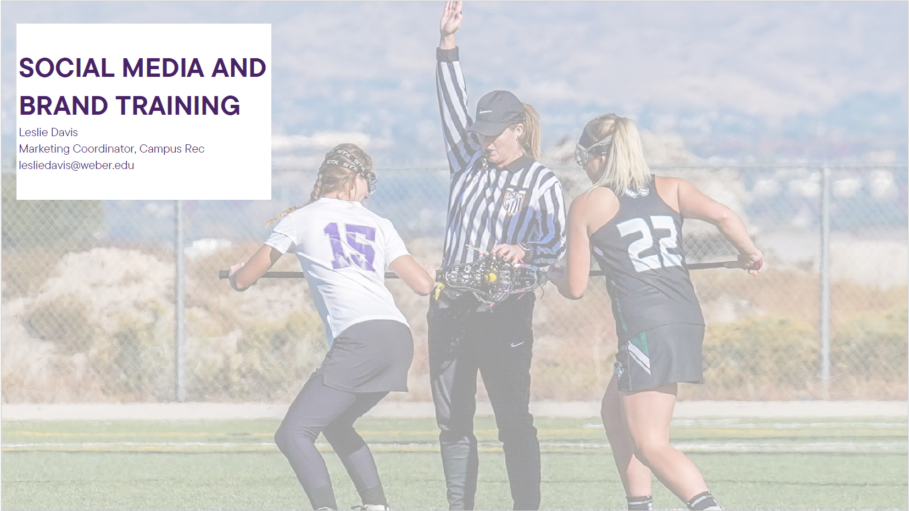
Sport Club Leadership Training

Slide 5

Sport Club Leadership Training

Slide 6

Sport Club Leadership Training

Slide 7
Overview

Slide 8
Sport Club Leadership Training
Expectations of Clubs
Don’t be “that person”
Your behavior effects:
  You and your future (student conduct)
  Your team
  All Sport Clubs
  Weber State University
Held to a higher standard

Slide 9
Sport Club Leadership Training
Expectations of Clubs
Student-Athlete
  Go to class
  Must keep a 2.0 to be eligible to participate
  Must have a 2.5 to be eligible for activity waiver
  Go to class
Eligibility Office/Registrar – do not contact them
Remember where you came from
  Give back, volunteer, pay it forward

Slide 10
Sport Club Leadership Training
Policies and Procedures
Expected to follow the PPM – Student Conduct and Policies listed in Sport Club Handbook (both online)
Zero tolerance stance on
  Hazing
  Alcohol or drug abuse
  Sexual Harassment
  Violence

Slide 11
Sport Club Leadership Training
Policies and Procedures
Websites & Social Media
Ask for permission first
CoSpo must have login information (be admin)
Must have University/CoSpo Approval
You are part of the University, be smart about what you post

Slide 12
Club Requirements

Slide 13
Sport Club Leadership Training
How to Exist as a Sport Club
Have at least 6 active members
Have at least 2 club leaders and 2 safety officers
Hold regular meetings/practices
Compete on your level
  Recreational
  Competitive-Recreational
  Competitive
Meet CoSpo deadlines
*We register you with Clubs and Orgs

Slide 14
Sport Club Leadership Training
Important Deadlines
Website
Must be submitted 2 weeks before first competition or the online deadline (whichever comes first):
  Constitution
  Competition Schedule
  6 Approved Student Members
  Dues Paid
  Leadership Voted in; Safety Officers Approved

Slide 15
Sport Club Leadership Training
Member Restrictions
All WSU students must be allowed to join your club
  No “cutting” players
  May limit who makes the traveling or competing team
  No minors
Club must be no more than 20% non-students
  Includes faculty, staff, and community members
  Non students members are voted in by student members

Slide 16
Sport Club Leadership Training
Member Restrictions
All clubs must set dues
Minimum dues per member per year
  Recreational: $10
  Competitive – Recreational: $60 for comp, $10 for rec
  Competitive: $130
Dues can be waived for no more than 4 members*

Slide 17
Sport Club Leadership Training
Member Registration
Intro to DSE
  https://weber.edu/sportclubs/clubs.html
  Register as a student/faculty/staff
    Issues? Most likely missing Wildcard
  Register as a community member
    Issues? Most likely need club to tell CoSpo to give them access to clubs.

Slide 18
Sport Club Leadership Training
Club Leadership
Clubs are run by students for students
Only students may be club leaders
Clubs must have at least 2 officers
  Usually President and Vice President
  Duties defined in constitution
Clubs must also have 2 Safety Officers and Trip leaders
  Safety Officers must be trained in CPR/First Aid/AED and complete Canvas Training

Slide 19
Sport Club Leadership Training
Club Leadership
Leadership votes must be supervised by CoSpo Office
Votes can happen:
  In person (at an agreed upon practice/event/etc.)
  Online (via google form link)
  In the Campus Rec Office

Slide 20
Sport Club Leadership Training
Coaches and other Volunteers
All volunteers are there to help the club
Volunteers cannot do the leadership duties
  Should stay within volunteering duties
Volunteers can be dismissed at any time for any reason including, but not limited to:
  Failure to meet responsibilities
  Acting outside of responsibilities
  Not representing WSU in the highest degree

Slide 21
Sport Club Leadership Training
Constitution
Document that explains what your club is about
This is a tool to help you
Must be voted in by 60% of members by CoSpo Office supervised vote
Template online to help you get started

Slide 22
Requests

Slide 23
Sport Club Leadership Training
Sport Club Website
https://www.weber.edu/sportclubs
Live out of that site
  Register as a member
  Send all requests

Slide 24
Sport Club Leadership Training
Purchases
Submit a purchase request and have it approved before you do anything!
Detail out exactly what you want to purchase:
  Quantity
  Unit price
  Shipping costs
  Total costs
  How payment is to be made

Slide 25
Sport Club Leadership Training
Purchases
If approved, CoSpo office will help you with next steps. But usually, not always, purchases
  <$200: you buy and are reimbursed
  $200<$1500: CoSpo office buys with credit card
  >$1500 or requires a check: Requisition will be place (need an itemized quote)

Slide 26
Sport Club Leadership Training
Purchases
Must be approved first otherwise you are personally responsible for the purchase
No more after the fact purchases ($1500+ or checks)
No matter what the purchase was, the CoSpo office must get an itemized receipt for every purchase made.

Slide 27
Sport Club Leadership Training
Purchases - Officials
Must have a quote and be submitted through purchasing 2 weeks before your game(s)
Contact the assigner for estimated costs of officials per game, assigner fees, and if we pay the assigner or officials directly
Can adjust as needed, just needs to be in place BEFORE games

Slide 28
Sport Club Leadership Training
Purchases – Requires a Contract
Contracts must be approved by legal first
  Sometimes legal teams of both parties have negotiations which slows down the process
Only Vice Presidents of the University may sign them
If facility, items, etc., require an agreements or contract, you must submit it to CoSpo office at least a month before event to give it time to go through proper channels

Slide 29
Sport Club Leadership Training
Tryouts (Events in DSE)
Will use the paper waiver from online
  Only valid for the days/times listed
Everyone must sign paper
Allows for tryouts without members paying dues or completing all DSE items

Slide 30
Sport Club Leadership Training
Setting up Practices
Submit an event on DSE for one practice
  List all available days, times, duration, and time frame
  Ex: 2 hour practices on Mon/Tues/Wed anytime after 6p from first week of classes until November 1st
Once approved, DSE will update and you get emailed
Approved practices are on Sport Club Calendar to alert other entities (ex: Ats, Campus Staff, Police, etc.)

Slide 31
Sport Club Leadership Training
Setting up Practices
Only those listed on the approved roster may practice
Exception: first time practice – sign paper waiver
Good for 1 practice only

Slide 32
Sport Club Leadership Training
Practice with CoSpo Supervisor
CoSpo Supervisor will:
  Bring the keys to unlock fields (if on campus)
  Bring the binder with the roster
  Verify IDs of everyone at practice
  Report back to the CoSpo Office
Leadership will:
  Assist Supervisors with their requests
  Ensure all members check in with IDs to the Supervisor

Slide 33
Sport Club Leadership Training
Practice without CoSpo Supervisor
Leadership will:
  Print the practice roster form emailed to them by CoSpo Managers
  Ask Campus Rec office to unlock/lock facility
  Check off members on roster paper who were at practice
    Do not allow non-members to participate
  Return practice roster to Sport Club office with notes on how practice went (issues, injuries, injury report forms, etc.)

Slide 34
Sport Club Leadership Training
Cancelling Practices
Must inform CoSpo Staff 24 hours in advance of cancellation or unproductive practice otherwise you will be fined
  Be respectful of peoples’ time
  Other clubs might want your space
Clubs must have at least 40% of members present and/or have a productive practice for a practice to count as not being cancelled.

Slide 35
Sport Club Leadership Training
Home Events
Submit an event request 2 weeks before event
  Be specific in what you want and need
  Include requirements (insurance, contracts, payment types)
  Submit a purchase request (if needed)
Once approved, inform team
  Finalize roster 48 hours before event
Inform CoSpo staff of any changes or cancellations ASAP

Slide 36
Sport Club Leadership Training
Traveling
Submit a travel event at least 1 week in advance
  Roster finalized 48 hours before the club leaves
  The earlier the better
    Day trips, no overnight stay – 1 week is fine
    Overnight trips with rental cars/hotel rooms – 1 month
Work with Manager on specific details of travel

Slide 37
Sport Club Leadership Training
Traveling
Submit a purchase request for all travel expenses:
  Hotels
  Entry Fees
  Food
  Gas Reimbursement
  Rental Cars
  Airfare
  Pcards expenses during trip (meals, etc.)

Slide 38
Sport Club Leadership Training
Travel Issues
Transportation issues
Lodging issues
Other non injury related issues
Regardless let your Manager know immediately

Slide 39
Sport Club Leadership Training
Traveling
You will meet with your Manager before traveling to get the travel binder and go over last minute items
Bring all receipts back
  Must be itemized
  Must be signed
Include all accident reports
Travel binder must be returned by 10am the business day after their clubs return

Slide 40
Sport Club Leadership Training
Purchasing Card on Trips
So many issues that the university is considering taking them away
All purchases that are going to go on the Pcard must be preapproved prior to the trip
  Card is pre-loaded with funds
  Must have an itemized receipt brought back
    Not just the total
    Every. Item. Purchased. Listed.

Slide 41
Sanctions & Fines

Slide 42
Sport Club Leadership Training
Sanctions
Mistakes happen but you are still held responsible and accountable
  Incident Report forms
  Warnings
  Fines
  Other actions
Can appeal sanctions to SCC provided it meets the conditions in the Sport Clubs Handbook
Just ask before making the mistake!

Slide 43
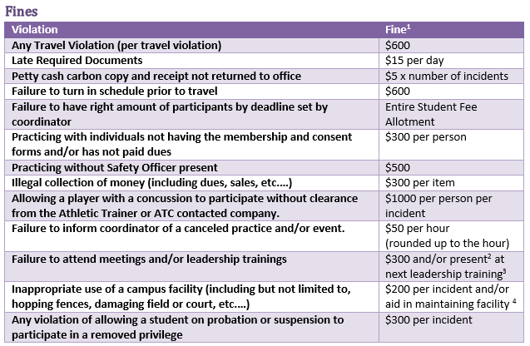
Sport Club Leadership Training
Fines

Slide 44
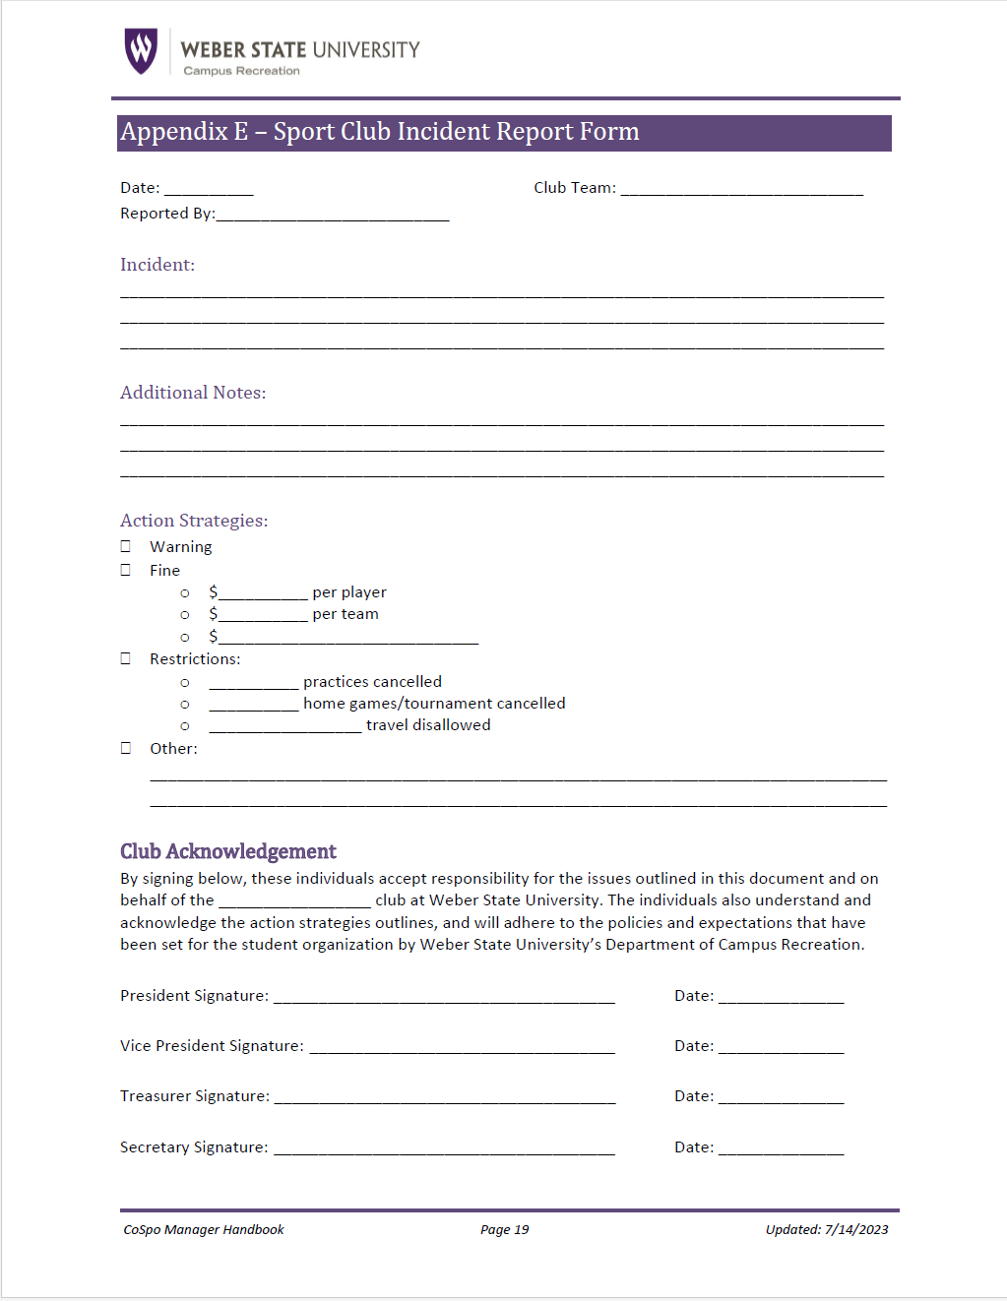
Sport Club Leadership Training
Incident Report

Slide 45
Injuries & Emergencies

Slide 46
Sport Club Leadership Training
Emergency Action Plan
Included in your travel binder
  Personal injury, concussion management, fire, bomb threat, power failure, lightning, etc.
Canvas Course training
Can also be found online >> Handbook

Slide 47
Sport Club Leadership Training
Injury During Play
Assess the situation for severity of the injury
Perform appropriate care for the injury on scene
If appropriate, call 911 or take the player to the hospital
  Safety Officer/Trip Leader stays with the person until a relative arrives or the victim is discharged from the hospital
Once hospital transportation arrives inform the CoSpo staff of the situation and victim status.
Write an Accident Report.

Slide 48
Sport Club Leadership Training
Non-Life Threatening Injury
Perform appropriate care for the emergency
Have someone call for transportation to the hospital if needed
  Safety Officer/Trip Leader stays with the person until a relative arrives or the victim is discharged from the hospital
If needed, recommend that the victim seeks further medical care.

Slide 49
Sport Club Leadership Training
Non-Life Threatening Injury
Once hospital transportation arrives, inform the CoSpo Staff of the situation and victim status.
Fill out an Accident Report.

Slide 50
Sport Club Leadership Training
Life Threatening Injury
Call EMS and give victim status.
Say “My name is (your name) and I am calling from (location). I have a victim who (insert symptoms here). Please send an ambulance to (specify entry point location). I will have someone there to meet you.”
Direct a specific person to find an AED
Perform appropriate care until EMS arrives and takes over

Slide 51
Sport Club Leadership Training
Life Threatening Injury
Safety Officer/Trip Leader stays with the person until a relative arrives or the victim is discharged from the hospital
Once hospital transportation arrives, inform the CoSpo Staff of the situation and victim status.
Fill out an Accident Report

Slide 52
Concussions

Slide 53
Sport Club Leadership Training
Concussions
A concussion is a serious brain injury.
Concussions can occur in any sport or activity and can occur without the loss of consciousness
It is important to:
  Recognize
  Give proper management of a concussion
  If not taken care of properly the concussion can lead to further injury or death

Slide 54
Sport Club Leadership Training
What is a Concussion?
An injury that changes how the cells in the brain normally function
Caused by the brain being forced to move rapidly inside the skull
Many times leading to bruising of the brain

Slide 55
Sport Club Leadership Training
Recognizing a Concussion
A forceful blow to the head or body that results in rapid movement of the head
Any change in the athlete’s behavior, thinking, or physical functioning

Slide 56
Sport Club Leadership Training
Signs Observed
Appears dazed or stunned
Is confused about assignment or position
Forgets sports plays
Is unsure of game, score, or opponent
Moves clumsily
Answers questions slowly
Loses consciousness (even briefly)

Slide 57
Sport Club Leadership Training
Signs Observed
Shows behaviors or personality changes
Can’t recall events prior to hit or fall
Can’t recall events after hit or fall

Slide 58
Sport Club Leadership Training
Symptoms Reported by Victim
Headache or “pressure” in head
Nausea or vomiting
Balance problems or dizziness
Double or blurry vision
Sensitivity to light
Sensitivity to noise
Feeling sluggish, hazy, foggy, or groggy

Slide 59
Sport Club Leadership Training
Symptoms Reported by Victim
Concentration or memory problems
Confusion
Does not “feel right”

Slide 60
Sport Club Leadership Training
Concussion Danger Signs
One pupil larger than other
Drowsiness or inability to stay awake
Progressively worsening headaches
Weakness, numbness, or decreased coordination
Repeat nausea or vomiting
Slurred speech
Convulsion or seizures

Slide 61
Sport Club Leadership Training
Concussion Danger Signs
Cannot recognize people or places
Become increasingly confused, restless or agitated
Loss of consciousness

Slide 62
Sport Club Leadership Training
Prevention and Preparation
Education about concussions
Insist that safety comes first
Teach athletes and parents that it’s not smart to play with a concussion
Prevent long-term problems

Slide 63
Sport Club Leadership Training
What should you do when a concussion is suspected?
Remove the individual from play or the activity
Ensure that the athlete is evaluated right away by an appropriate health care professional
Inform the individual’s family or friends about the possible concussion and inform them of some of the signs and symptoms to look to
Allow the individual to return to play or activity only with permission from a health care professional with experience in evaluating concussions

Slide 64
Sport Club Leadership Training
Return to Play Policy
Once an athlete has been restricted from Sport Club participation due to injury or illness, as determined by any member of the CoSpo Staff, that athlete may not return to participation until cleared by a qualified healthcare provider.

Slide 65
Sport Club Leadership Training
Return to Play Policy
The athlete must submit a written statement from the qualified healthcare provider which affirms that (1) the provider has, within three years before the date on which the written statement is made, successfully completed a continuing education course in the evaluation and management of a concussion, and (2) participant is cleared to resume participation in the sporting event. The written statement should also include the name, contact information, and signature of the qualified health care provider

Slide 66
Sport Club Leadership Training
Return to Play Policy
Once the athlete has submitted the statement from the qualified healthcare provider to the CoSpo Assistant Coordinator/ Coordinator, written clearance will be given to the athlete when allowed to fully return to play. Returning to play without said clearance is a violation of this policy and grounds for suspension.

Slide 67
Sport Club Leadership Training
Concussion Testing
Athletic Trainer, Breanna Cutler, handles that
Possible new option where it is emailed to club members
  Specific details to follow…

Slide 68
Hazing

Slide 69
Sport Club Leadership Training
Hazing
In short, hazing is any action taken or situation created intentionally:
  That causes embarrassment, harassment, or ridicule.
  Which risks emotional and/or physical harm to members of an organization or team.
  Whether they are new members or not, regardless of the person's willingness to participate.

Slide 70
Sport Club Leadership Training
Is it Hazing?
Ask yourself:
  Would I feel comfortable participating in this activity if my parents were watching?
  Would we get in trouble if the Dean of Students walked by?
  Am I being asked to keep these activities a secret?
  Am I doing anything illegal?
  Does participation violate my values or those of my organization?
  Is it causing emotional distress or stress of any kind to myself or others?
If the answer is yes, it is most likely hazing.

Slide 71
Sport Club Leadership Training
Level 1 Hazing Includes:
Second class membership such as:
  Not allowed to wear certain types of letters
  Forced to wear “gear” or a certain type of “uniform”
  Can’t use certain entrances or stairways, etc.
  Activities that subject members or prospective members to public nuisance, spectacle, or buffoonery
  Not told when initiation will be

Slide 72
Sport Club Leadership Training
Level 1 Hazing Includes:
Personal servitude such as:
  Cleaning
  Doing errands for members
  Required interviews and sign-offs with members

Slide 73
Sport Club Leadership Training
Level 2 Hazing Includes:
Psychological and emotional games and intimidation:
  Scare tactics or war stories about what they will go through
  Spotlight quizzes or yelling
  Forced sharing of embarrassing stories
  Forced participation in humiliating activities
  Morally degrading activities that cause extreme embarrassment or which are contrary to the individual’s moral values or religious beliefs.
  Streaking or other activities requiring various forms of undress
  Singing embarrassing or sexually explicit songs
  Forced performance in front of a group
  Simulation of sexual activities

Slide 74
Sport Club Leadership Training
Level 3 Hazing Includes:
Physical:
  Hitting or beating of any kind, including, but not limited to, paddling, slapping, kicking, pushing, yelling, biting, duck-walking, calisthenics, or excessive exercise under pressure
  Branding or burning
  Forced tattooing
  Carrying of heavy objects
  Tampering with or vandalizing a person’s personal belongings which could cause physical pain or discomfort
  Being subjected to extreme temperatures or harsh elements
  Forced or coerced consumption of alcohol, drugs, or other substances, including water
  Dietary restrictions of any kind that a member is obligated to follow in order to be accepted by the organization
  Sleep deprivation activities that deprive prospective members of the opportunity for sufficient sleep

Slide 75
Next Steps

Slide 76
Sport Club Leadership Training
Upcoming Deadlines
Constitution
Member Registration
Dues
Competition schedule
Facility Request (practices)
Leadership
  All due by September 8th or 2 weeks before competition

