Slide 1
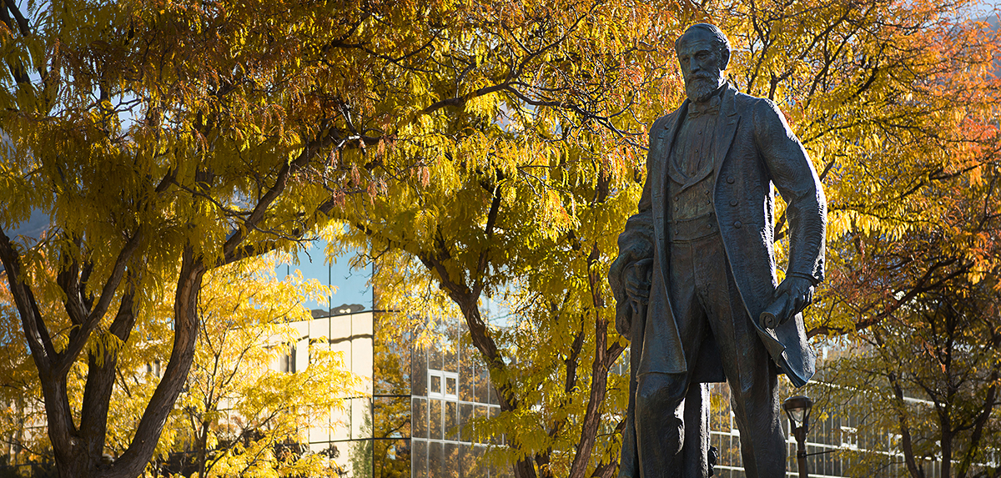
Club Leadership Training 10/11/23

Slide 2
Issues So Far
Home Events, clarification
While you list the full reservation time, in the notes indicate the setup time and start time
Example: Set up field from 11-12; warm up; games starts at 12:30p
Need to be approved 2 weeks out to guarantee AT coverage
Approved means facility is secured, google calendar is updated and event is approved in DSE
Have until 3 days out to finalize the playing roster

Slide 3
Issues So Far
Purchase Requests
Be detailed. Include:
Unit prices
Total costs
Quantity and Sizes
Who to contact if we have questions
How do we pay (credit card, check, etc.)
Is there a link? A login? What is the username/password?
Is there a quote (say email to follow, or emailed to Morgan 10.11.23)

Slide 4
Issues So Far
Purchase Requests
Don’t make us do any digging
We should have all the information in that request to know if you have enough money to make the purchase and direct you on what the next steps are
If this is for a travel, include bus, rental cars, hotels, meals, etc.
We need the quotes for these things
Meals would be (we plan to eat at this restaurant and spend no more than $300)

Slide 5
Issues So Far
Receipts
We. Need. Receipts. For. All. Purchases.
Bought something from the bookstore, printing services or somewhere else on campus with we gave a Cost Code?
Bring us the receipt
Stayed in a hotel?
Get the receipts
Hotel said they will email us? They won’t. Get a receipt for all rooms when leaving

Slide 6
Issues So Far
Travels for multiple games, Tournament
Going to Denver to play CCU, DU, and MSU Denver over the course of the weekend 10/13-10/15
Do not put in DSE as individual games
Put in DSE as a Tournament (even if the games are unrelated)

Slide 7
Issues So Far
Travels for multiple games, continued
Put in DSE as Tournament (even if the games are unrelated)
Event/Opponent Name: Denver Trip
Event Start: Time you are leaving campus
Event End: Time you are arriving back to campus
Location: Away
Notes: Who you plan to play
Then in the report, click “+Add Result” to list out the individual games and the results

Slide 8
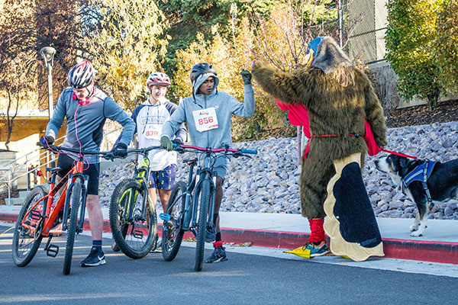
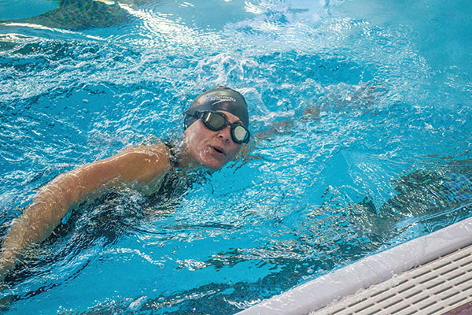
Turkey Tri Volunteer Incentive
Volunteers are needed for the Turkey Tri

Slide 9
Turkey Tri Volunteer Incentive
Thu Nov 2: 5-6:30pm
packet stuffing
Fri Nov 3: Afternoon
early packet pick up at Ogden Running Co.
Fri Nov 3: 6-7:30pm
mandatory volunteer meeting and moving equipment
Sat Nov 4: 6:30am-12pm
optional shifts of 6:30-8:30 and 8:30-12 or all day
Need a turkey

Slide 10
Turkey Tri Volunteer Incentive
Two $200 winners*
Team with the most volunteers
Team with the most hours
Two $100 winners*
Team with the second most volunteers
Team with the second most hours
*If a team has the most volunteers and the most hours they can win both prizes

Slide 11
Turkey Tri Volunteer Incentive
Register by November 1st
Sign up online here or if you need credit in Give Pulse sign up here.
There will be a sign in sheet for you to designate which club you are with at the event
Volunteers do no need to be limited to club members
Roommate, friends, classmates want to help?
They can volunteer and get credit as your club

Slide 12
Travel Changes

Slide 13
WSU Overnight Travel Changes (day trips remain the same)
Starting November 1st?
All university travel and purchases will be in a new system called Concur
It will be an App in your eWeber Portal
It will be an App on your phone
Will require a lot more work on your end
Its not set up for group travels but we have to make it work

Slide 14
WSU Overnight Travel Changes (day trips remain the same)
Unless the purchase is preapproved and set up correctly on Concur you will not be able to purchase it or be reimbursed

Slide 15
WSU Overnight Travel Changes
Starting November 1st?
All those being reimbursed must be in the Concur and have completed the in-person travel trainings with the purchasing department*
All those with a Pcard must be in the Concur system and have completed the in-person Pcard training with Purchasing*
Teams must have at least 1 Pcard
Whoever’s name is on the Pcard must go on the trip
*These are different trainings

Slide 16
WSU Overnight Travel Changes
Known issues with club Pcards
Only the person whose name is on the card can use it
It is a declining balance card; not a credit card
Think of it as a gift card
What we preload on the card comes out of the club budget regardless if used or not
That amount does not go back into the club budget until card is closed out/canceled.
If you overspend while on a trip, you become personally responsible for those purchases
Lots of responsibility on the Pcard holder

Slide 17
Process Moving Forward (as of today, could change as more information becomes available)
Submit the overnight travel in DSE and the Purchase request as normal (this has not changed)
Include who will be reimbursed and for what
Example: Emma reimbursed for driving to MSU Denver (508 miles one way/1016 miles roundtrip at $0.30/mile = $304.80 total)
CoSpo office will set up all approved trip expenses (hotels, rental cars, meals, registrations fees, mileage reimbursements, etc.) in Concur prior to travel
This includes working with Christopherson
Pcard will be loaded with approved funds for the trip
This Pcard will now pay for hotel, rental cars, entry fees, etc
Pcard holder and those being reimbursed must go in and approve/agree to the trip terms in Concur 1 week before travel

Slide 18
Process Moving Forward (as of today, could change as more information becomes available)
When picking up the binder, now you’ll check out the Pcard as well
Pcard holder will make all purchases during trip
Take pictures and upload receipts in real time to Concur using the app
Must indicate on the “attending form” in the app who ate if meals were purchased
Return travel binder and Pcard by 10a the next business day after returning to campus (this has not changed)
CoSpo Office will look through Concur trip and verify you have done everything correctly. They will then either send the report to you to approve or ask you to complete outstanding tasks
If this is not completed within 3 days, clubs will be shut down until this is finalized. This includes practices
Pcard holders must complete Pcard Statements in Concur Monthly within 7 days of it being closed (this due date is TBD)

Slide 19
If you cannot handle that responsibility do not become a Pcard holder!

Slide 20
Risks
Strict 3 Strike policy
Violate purchasing policies/protocols 3 times, you loose your privilege to be a Pcard holder or be reimbursed
Risk losing more funds from club account than intended
Risk being shut down as a club

Slide 21
WSU Overnight Travel Changes
If you intend to have an overnight travel, your club must have a Pcard
Teams with Pcards
Hockey: Bryon Fobair
Men's Rugby: Jai-Ja Lee
Weightlifting: Giovanni Volpi
Table Tennis: Andreas Bolos
Pending Pcard
Soccer: Peter Ingman
Determine who on your club is responsible enough for a Pcard.
Submit these forms back to CoSpo Office

Slide 22
Next Steps
Determine who should have a Pcard
Complete and return the form
Start solidifying travels now
Who will drive/be reimbursed
Where you’ll be staying
The days of travel being flexible are gone, so you need to step up or your club won’t be traveling

