Slide 1
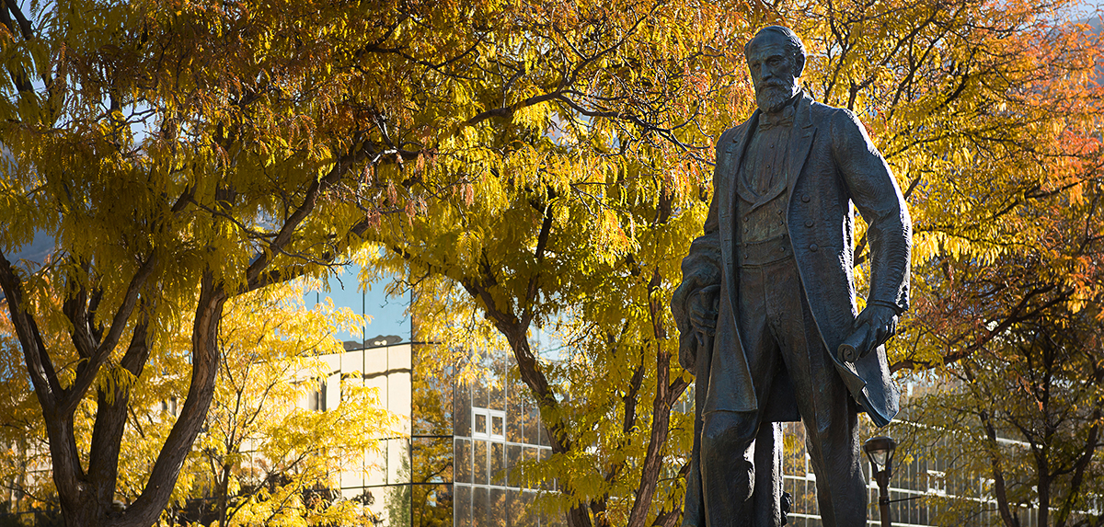
Club Leadership Training 11/15/23

Slide 2
Risk Management for Sport Clubs
Fall 2023

Slide 3
General Requirements
Safety Officers
Each club is required to have 2 Safety Officers, and a Safety Officer must be present at all practices and competitions
First Aid
First Aid kits are available for clubs to check out for practices and competitions.
Check out First Aid for any practice/event that does not have an athletic trainer scheduled
Packs need to be checked in/out through DSE at the Campus Rec Office

Slide 4
Reporting Procedures
When a Player is Injured
After care is given, an Accident Report should be filled out immediately, even if game play has resumed
If EMS is called or the player is transported to the hospital, your Club Sports Manager (Seth, Rachel or Josh) needs to be notified ASAP
Reports should be turned in with your binder in a timely manner
Let your Club Sports Manager know if there is a report in your binder

Slide 5
Reporting Procedures
For Non-Injury Incidents
If one of the following happens, an Incident Report needs to be filled out and your Club Sports Manager should be notified:
Violence or threat of violence
Harassment
Theft
Any situation in which police are called

Slide 6
How to Fill out Reports
Be Prompt
Fill out reports immediately after the accident/incident occurs
Be Thorough
Don’t skip sections of the form
Use Proper Grammar
Use full sentences and correct grammar. Avoid shorthand or sport specific/medical jargon
Penmanship
Make sure your writing is legible
Don’t Make Assumptions
Only write what you know as fact.

Slide 7
Sample Report

Slide 8
Questions?

Slide 9
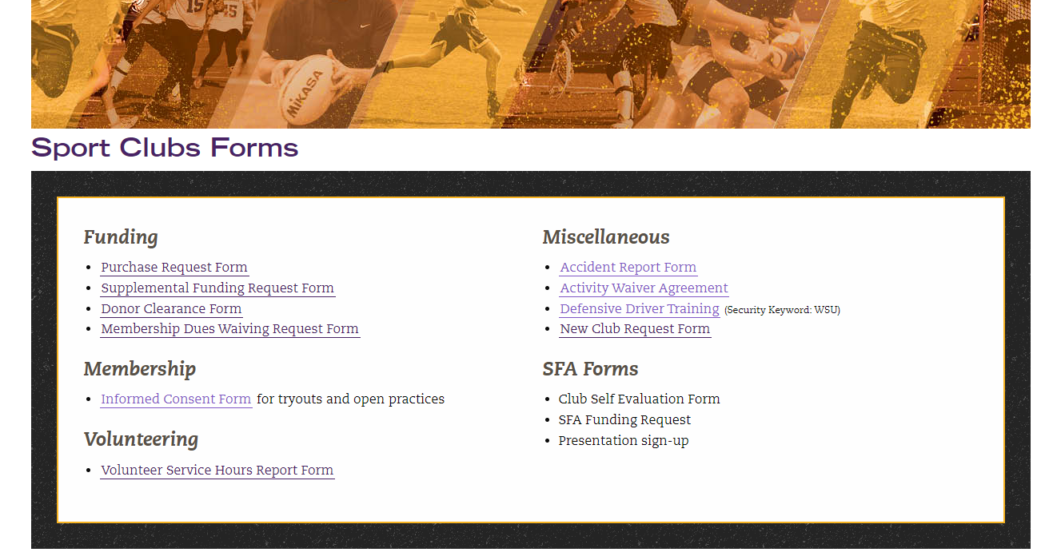
Volunteer Service Hours
New Form Available Online https://weber.edu/sportclubs/forms.html

Slide 10
Volunteer Service Hours
Allows us to track who completed hours
Include the name of the event
Date and start/end times
List everyone from the club who was there
Need at least 3 people from the club for it to count toward club hours
Verification information
Be sure to list a contact of someone who will verify your service hours. This person should not be related to the club.

Slide 11
Pcard Update
Who knows
We got all set up for training then were told not to have you attend them
Business as usual?
Each person with a Pcard must follow these steps so Morgan can have access to assist

Slide 12
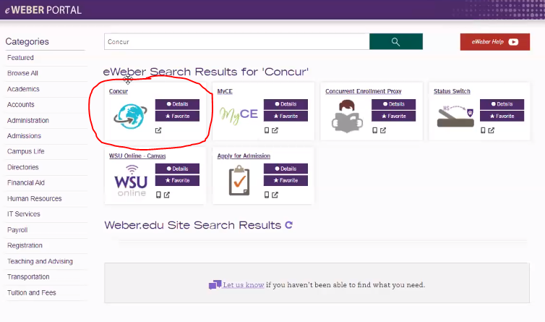
1. Log in eWeber Portal Search and select Concur

Slide 13
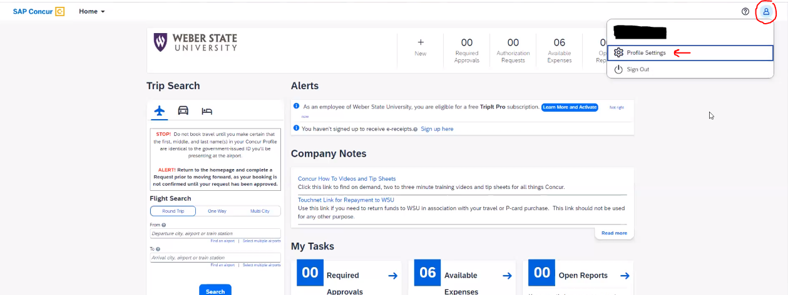
2. Click on the person then on Profile Setting

Slide 14
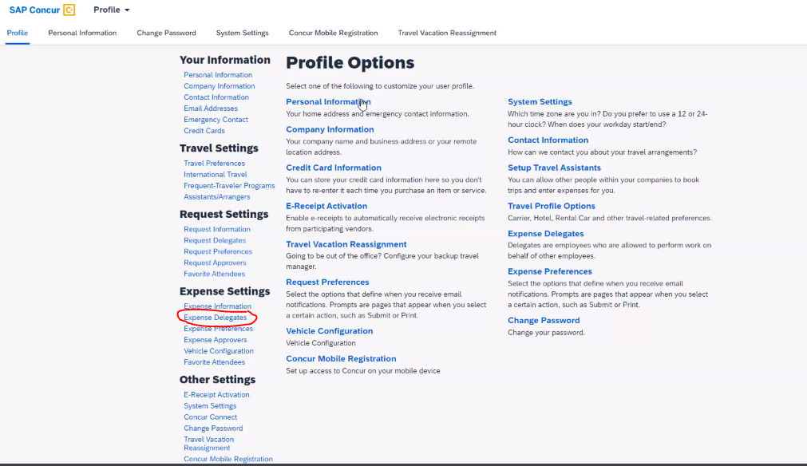
3. Click on Expense Delegates

Slide 15
4. Click Add

Slide 16
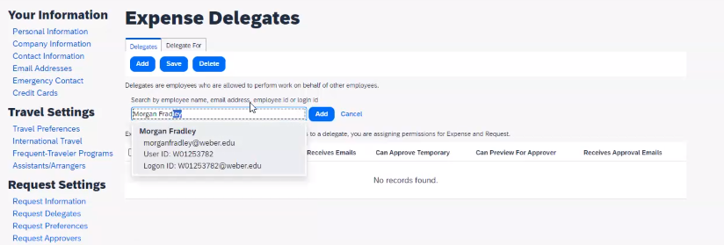
6. Search for Morgan Fradley Click add
5. Click Add

Slide 17
7. Check most boxes Click Save

Slide 18
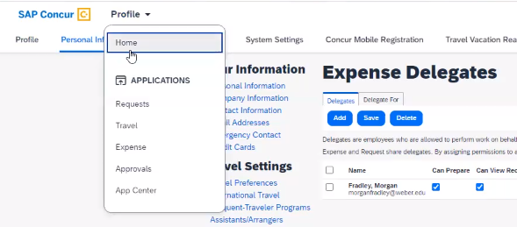
Verifying Expense Reports
You must verify the statement expense report each month you have charges
So only on travels with purchases on your pcard
Expense Report - Start at the Home Screen

Slide 19
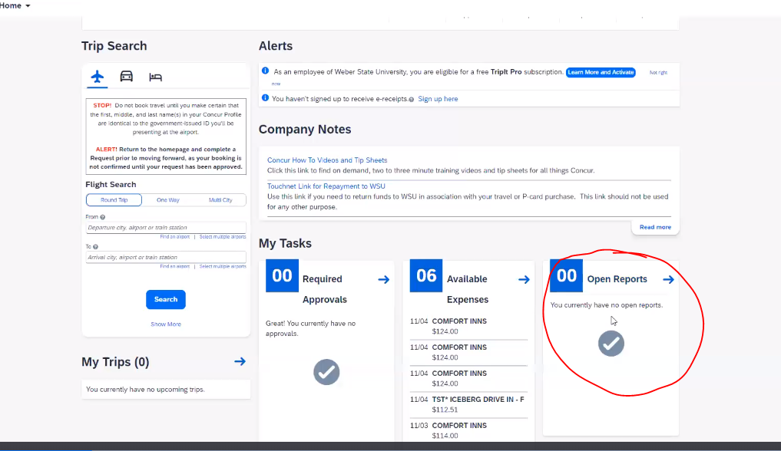
1. Click on Open Reports

Slide 20
2. Click on the Report for that month

Slide 21
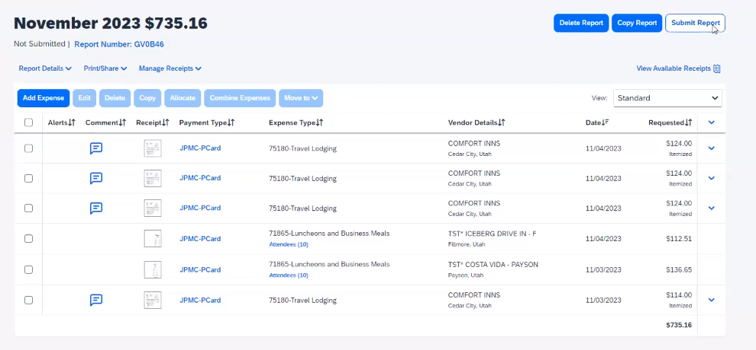
3. Click on Submit Report

Slide 22
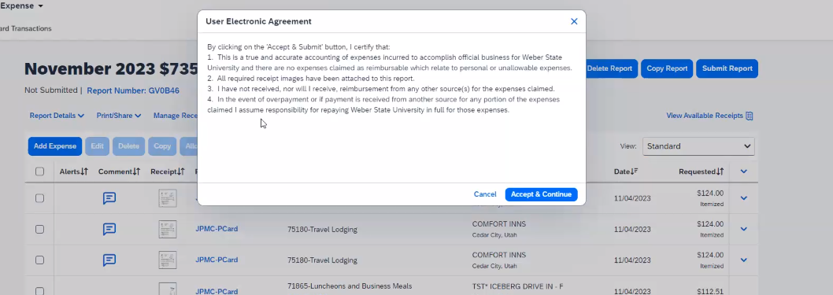
4. Click on Accept & Continue

Slide 23
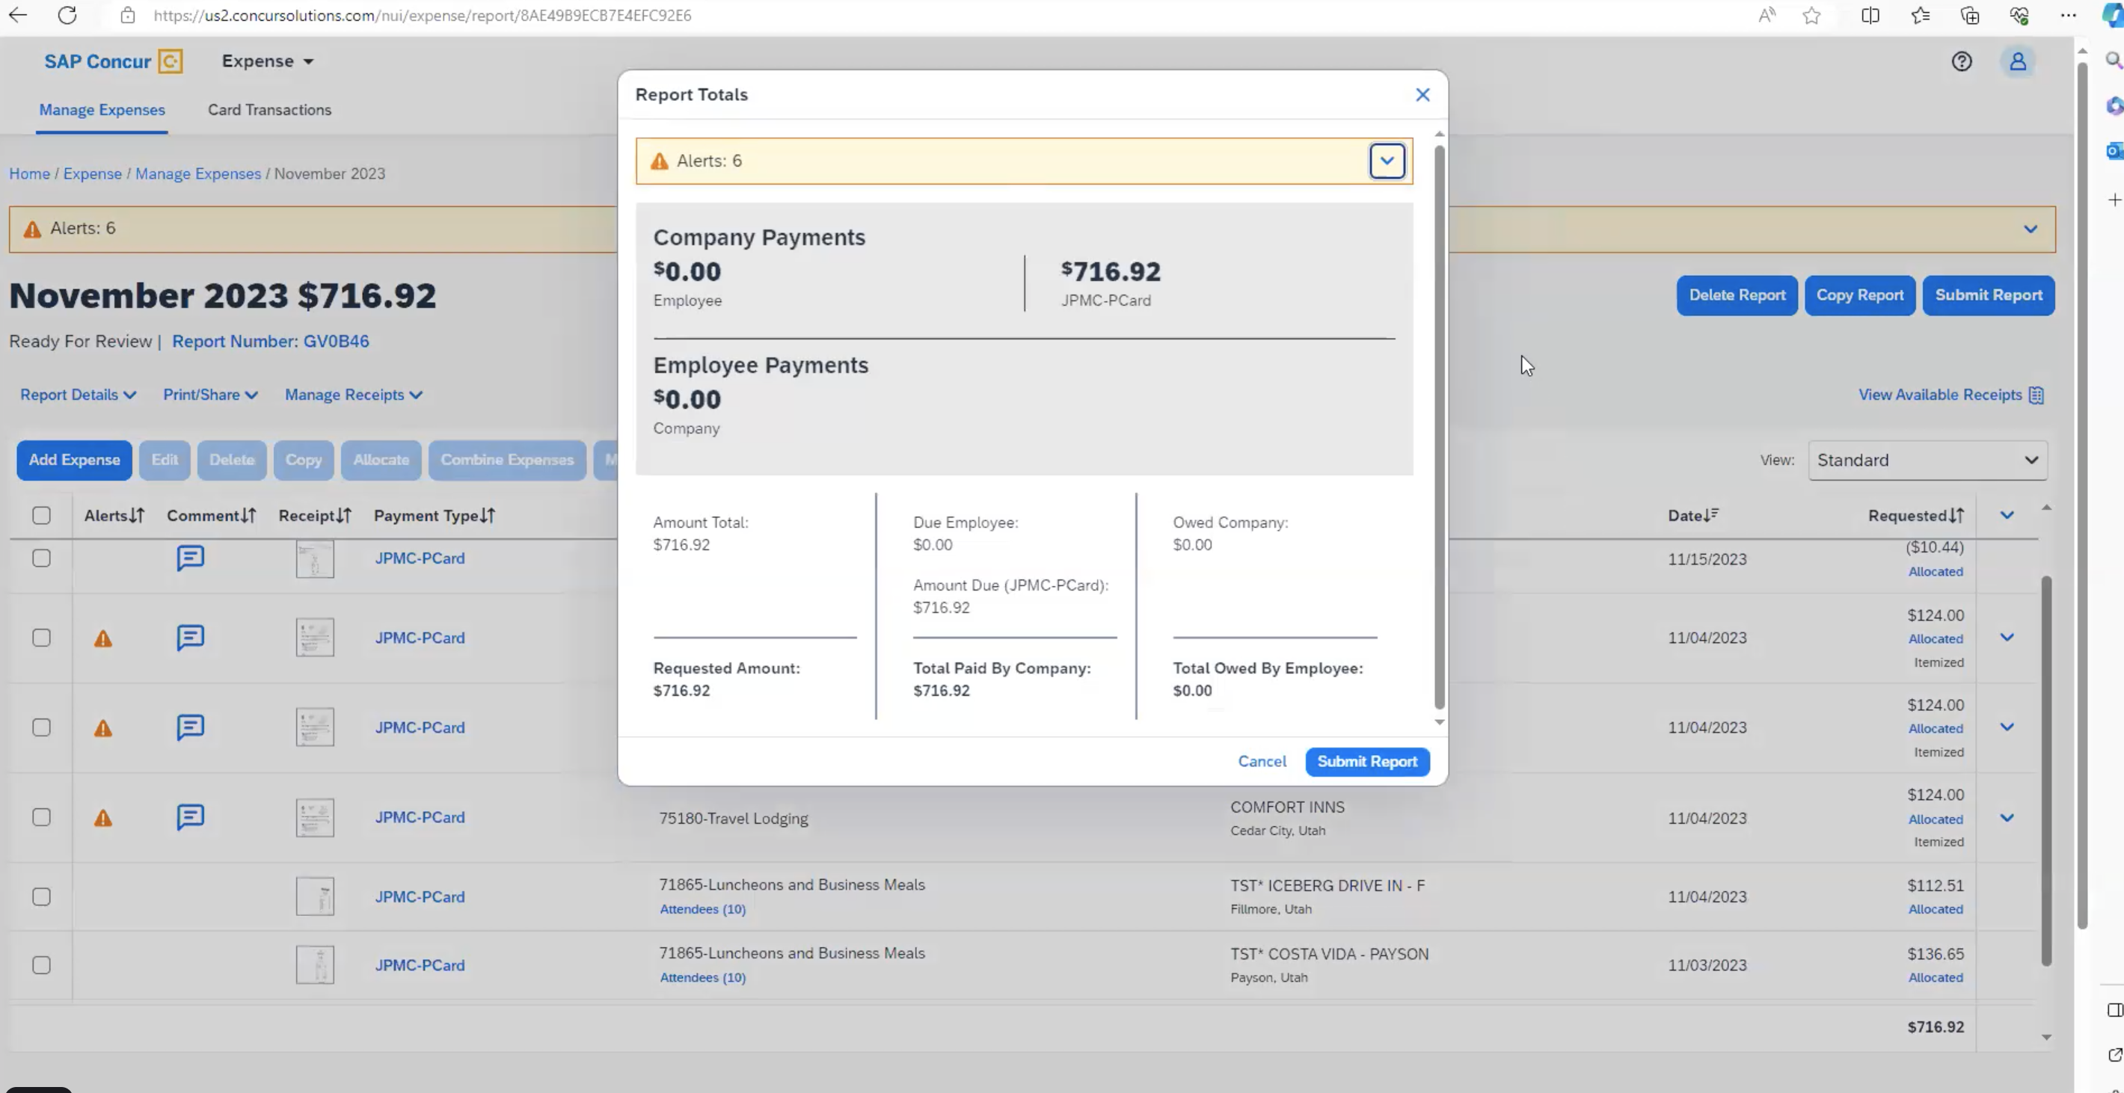
5. Click on Submit Report

Slide 24
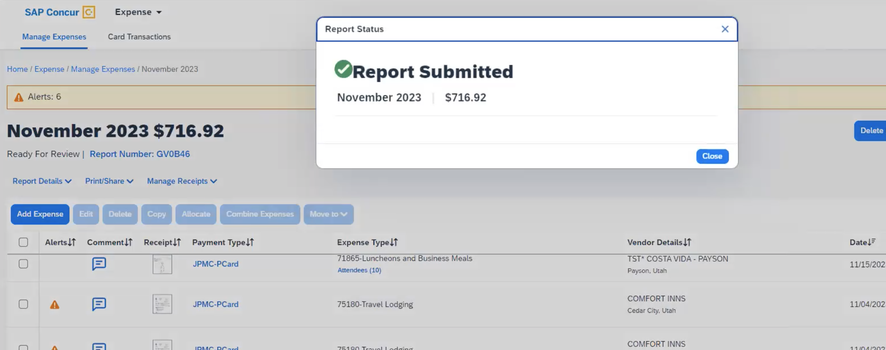
6. All Done! (You click close and log out)

