Slide 1
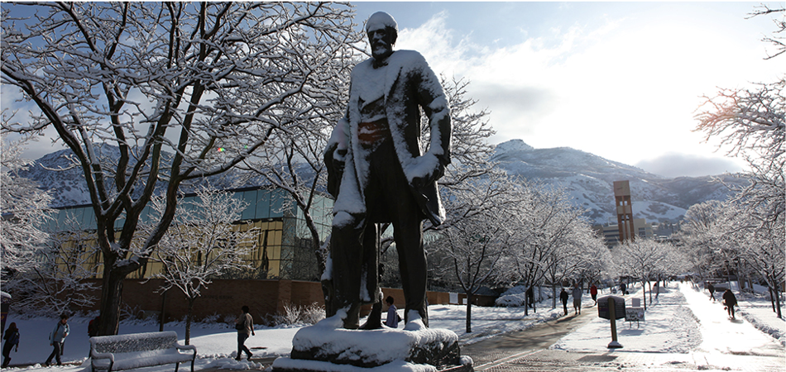
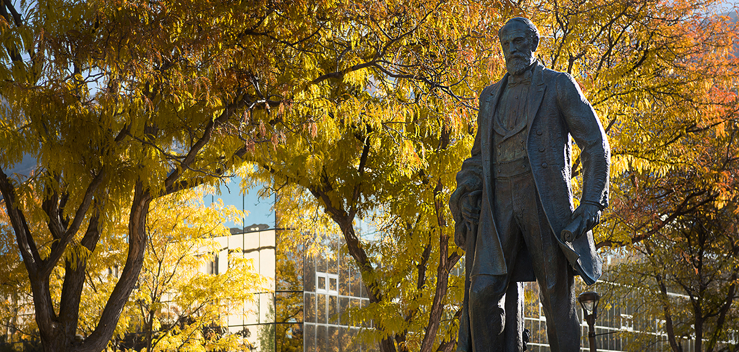
Club Leadership Training 1/10/24

Slide 2
Welcome to “Spring”
Please check your Spring dues on DSE to see if they are correct
One club’s dues disappeared
Another club had yearly dues incorrectly listed as semester dues
Get with your manager to ensure your dues on DSE are correct

Slide 3
Travel Update – Concur/Pcards
So far so good!
All those who traveled in November submitted their Pcard paperwork and it was (eventually) approved!
Follow the slides from the previous training to set up the monthly report and submit when needed

Slide 4
Clubs with Pcards
Baseball – Nick Garcia
Hockey – Bryon Fobair
Women’s Lacrosse – Anna Lindhardt
Women’s Rugby – Avery Parrish
Men’s Rugby – JJ Lee
Snowboard – Connor Healey
Soccer – Peter Ingman
Table Tennis – Park Polos
Weightlifting – Giovanni Volpi
If your club has overnight travel this semester and the person listed is not going, you must get another card.
If your club is not listed, get a card.

Slide 5
Clubs with Pcards that need to give Morgan Concur Access
Baseball – Nick Garcia
Hockey – Bryon Fobair
Women’s Lacrosse – Anna Lindhardt
Snowboard – Connor Healey
Weightlifting – Giovanni Volpi
Follow the steps in the previous training on how to do that.

Slide 6
Purchasing Update
$2,500 is the new credit card purchase limit
Must submit a purchase request still
Will place on Morgan’s pcard

Slide 7
Mileage Reimbursement Update
The new mileage rate is $0.30/mile or $0.655/mile
Previously is was $0.18/mile or $0.38/mile
If you want to provide less mileage, let us know
We might be able to reduce the amount/mileage if you feel members are receiving too much in return.
Must still submit a purchase request before the trip to ensure club has the funds for it and tell manager which rate you want to use

Slide 8
Sport Club Council
They oversee any supplement hearings, disciplinary hearings, set general policies, and determine SFA and activity waiver allotment
Made up of 3 club leaders (must be from different clubs), 2 campus rec student employees, 1 faculty advisor, and 1 CoSpo Pro staff (Me – non voting member).
The club leaders receive $1,350 in activity waivers for their work on the council

Slide 9
Sport Club Council
We are now taking volunteers to replace 1-2 open seats
Those interested will send their platform via email to Morgan so she can compile a list of those that wish to run for the position
Morgan will email all members with the deadline and format of what should go in that email
Once she has completed the voting form, clubs will be able to vote on who should be elected for the sport club council

Slide 10
What is SFA?
Student Fee Allotment
Your chance to request funding and activity waivers for the 2024-2025 academic year
Proposed to the Sport Club Council

Slide 11
SFA Process Timeline
Submit Documents – January 26 by 5pm
Presentations to SCC – February 5-9
SCC Deliberations – February 12-19
Clubs informed of SFA/TW – February 19 by 5pm
Appeal Request – February 21
Appeal Hearing – February 27 – March 1
Final Amounts Emailed – March 29

Slide 12
Guidelines
To be eligible:
All members paid dues
Meet the deadline of the request (January 26)
Match the amount you received
Dues, fundraising, sponsorships, etc.

Slide 13
Amount to Request
No club may request more than 25% of the club’s previous allocation amount
Maximum amount to request
Competitive: $20,000
Competitive-Recreation: $10,000
Recreation: $500
Clubs requesting for the first time cannot ask for more than $1,000

Slide 14
Point Evaluation System
Funds are requested on a point evaluation system. Categories include:
Years of Experience
Team Success
Competition, Travel, Student Leadership, and overall function
GPA
Fundraising/Matching previous SFA
Community Service
Documentation
Member Retention and Success
Fiscal Responsibility
Sportsmanship

Slide 15
Items to Submit
Club Self-Evaluation Form (Google Form)
SFA Funding Request Detailed Sheet (Excel)
Presentation Sign up (Google Spreadsheet)*
Community Service (Google Form)
Due by 5:00 PM MST, January 26th

Slide 16
Club Self-Evaluation Form
Be as honest as possible
If there is a question you don’t know the answer to, contact your manager.

Slide 17
Funding Request Detailed Sheet
Activity Waiver Requests
Trip Expenses
Equipment Rental & Maintenance
Registration/Entrance Fees
Recreational Supplies
League Membership Dues
Guest Speaker Stipend
Office Supplies
Printing Costs
Facility Charges
Apparel and Uniforms
Athletic Trainer
Home Game Expenses
Club Income
Membership Dues
Entry Fees
Ticket Sales
Other Income

Slide 18
Presentations
Presentation Sign-Ups
February 5th – February 9th
Presentations are about 10-15 minutes with 5-10 minutes Q&A.
Presentations will be in front of the SCC and filmed for those who are not in attendance

Slide 19
Receiving Funds
Receive an email with an amount decided upon by the SCC by February 19th
Accept or Appeal amounts by 5pm Feb 21st
Have the option to appeal for more funds
If you choose to appeal, another hearing will occur
Do not lose any funds already awarded
Will not grant more funds that what you could ask for
Appeal Hearings will be week of Feb 27th

Slide 20
And now…
Self Evaluation Form
Submit Google Form
Explain Budget Form
Submit Excel File to Morgan or your Manager
Explain Sign up sheet for Presentation*
Enter information on Google Excel Form online
I’ll email club leaders when form is ready
Old Example: https://docs.google.com/spreadsheets/d/16WqT8k3xNIHn4fTbK4CTqu5NtX8ZfjzTm2pHCsM7m9c/edit#gid=2037421714

Slide 21
All forms found online

Slide 22
Any Questions?

