Slide 1
Welcome to Sport Clubs!

Slide 2
Summer To Do
Constitution
Maintain and update forms
Everything is wiped July 1st, 2019
Stay in contact with practices and cancellations
Fundraising
Volunteer Hours
Activity Waivers due April 29th!!

Slide 3
Constitution
Document that explains what your club is about
This is a tool to help you
Must be voted in by 60% of members
Template online to help you get started

Slide 4
Forms to Know
Over the summer some of you will be looking to hold practices, make purchases, get donors for your clubs, and add members.
All of these forms can be found at the link below:
http://www.weber.edu/sportclubs/forms.html

Slide 6
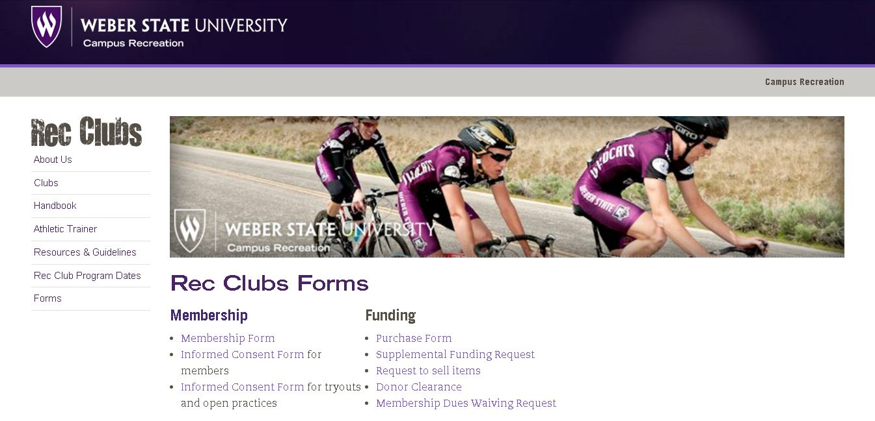
Membership/Informed Consent
http://www.weber.edu/sportclubs/forms.html
Both

Slide 7
Dues
Dues are set by each team individually.
These are to be paid in the Campus Recreation Office at the beginning of each semester.

Slide 8
Setting up Practices
Submit a Facility request for days/times
Be specific in what you want
Include requirements (insurance, contracts)
Submit a purchase request (if needed)
Once approved, inform team
Be sure membership/consent forms filled out and dues are paid by deadline in constitution
Inform CoSpo staff of any changes or cancellations ASAP

Slide 9
Buying stuff
Find the best deal and get quote
Submit a purchase request
If approved, CoSpo office will help you with next steps. But usually purchases
<$200: you buy and are reimbursed
$200<$1500: CoSpo office buys with credit card
>$1500: Requisition will be place (need an itemized quote)

Slide 10
Buying Stuff
Must be approved first otherwise you are personally responsible for the purchase
No matter what the purchase the CoSpo office must get an itemized receipt for every purchase made.

Slide 11
Donor Clearance
Enter in potential donors, reason for donation, and amount to be requested in the Donor Clearance Form.
CoSpo Office will send for approval from Development.
Once approved, a letter can be taken to donors.

Slide 12
Going Places
Enter in all requested information in the Travel Request
Due at least a week before hand but travels needing hotels, flights, rental cars, etc. need more time.
Notes:
Craig

Slide 13
Activity Waivers
Not scholarships – just waives part of the student’s tuition
Must meet requirements specified on form and those specified by club
Begin to decide who will receive and communicate with Morgan – due April 29th
Otherwise, Morgan will steal them from your club and redistribute them

Slide 14
Egg Dive
Friday, April 12th
$5/child
Free for WSU Students (with Wildcard)
Time Slots
Age 3 & Under: 5 p.m.
Age 4-6: 5:15 p.m.
Age 7-10: 5:30 p.m. and 5:45 p.m.
Age 11-17: 6 p.m.
WSU Student: 6:15 p.m.

Slide 15
Egg Dive
Volunteers needed – Contact Rebecca at rebeccamabile@weber.edu
Participants needed. Compete in the student category and win prizes
www.weber.edu/aquatics/eggdive.html for more information

Slide 16
Sport Club Council
Nominations
Votes – via Google form. Due by Friday 5pm

